Slide 1

Hosting Online Conferences and Symposiums using MS Teams
Joe Gasper Dewayne Hyatt
A #ShiftShow Production
Notes:
BACK AND FORTH?
Hello, I’m Dewayne Hyatt…
and I’m Joe Gasper.
We're systems administrators with the University of Florida’s Institute of Food and Agricultural Sciences, commonly called IFAS.
Prior to the pandemic shutdown, for almost a year, we had been traveling the state of Florida covering over 5500 miles training our remote faculty, scientists, and staff in our cooperative county extension offices and research centers on Microsoft Teams and OneDrive and the Microsoft 365 platform.
Now we’re not traveling so much are we – and the mission of the university hasn’t stopped. So with our experience of delivering Microsoft Teams and having a good connection to our faculty and administration, we were approached on how to continue to hold our traditional, in-person, symposiums and conferences. And today, we’re going cover what we have been doing with Teams as a platform for these important events.
IFAS fulfills the university’s land grant mission, working to enhance and sustain the quality of human life through its research facilities and extension services. The mission of IFAS is to take its knowledge around agriculture, human, and natural resources and make it accessible.
That mission has certainly become difficult in these uncertain times – surely not a unique experience. And the mission of IFAS, we’re sure is similar across universities. Often in pursuing this mission, we hold academic conferences and symposiums, as a way to share research, discoveries, new techniques, engage with colleagues, and students get a chance to showcase their academic and scientific work.

Slide 2
The Problem
Notes:
DEWAYNE
So, like all IT professionals we typically start off with the problem. Users bring issues to us. They have a broken system or broken software and it's our job to come up with a solution. We’re problem solvers. We're all very familiar with what the problem is, we've all been living it together for the last seven or eight months. The problem is this right here the photo on your screen. We've got rooms with empty seats, equipment that we can't use, auditoriums and hotels venues that are empty and our users are being forced to learn new technology on the fly. However, this isn't necessarily a problem for technology it might be an opportunity. It's an opportunity to teach people new skills and how to think about things through this new digital lens. There are things that they didn't necessarily have before, and I don't want to use the word forced but, in a way, they are being forced to adapt this new landscape. We're going to show you a few different ways that we've adapted alongside our users. By showing them some of the tools that they have access to and what we think are some great ways to put those tools to work for our institutions.
JOE
Maybe after doing this we will start to think of ourselves less as problem solvers and more as transformation agents, because by solving this immediate problem, it’s not just a quick fix. For the users it has a long-lasting impact and that's important to recognize not just for yourself but for the journey that it's going to create for your faculty, researchers, agents, and staff.

Slide 3
Why Teams?

Slide 4
Why Teams?
The “Virtual Venue”
Notes:
DEWAYNE
Teams becomes a digital representation of a physical conference.
Using this analogy helps end users make the connection between a physical venue with a lobby, rooms, lounge, etc. with a team which can be used in a very similar manner.

Slide 5
Why Teams?
The “Virtual Venue”
All content is in a single place
Notes:
DEWAYNE
Like a hotel, Teams allows us to keep all the conference content in one place. This reduces confusion and sets user expectations that any time they need something, check Teams.
JOE
When you go to a conference, you wake up in the morning, take a shower, go eat a plate of bacon, grab your coffee, and go the conference center – where you will spend your day.
Same concept with your conference Team – now perhaps minus the shower – but our goal is the same – you don’t’ need to leave the team once you’re there.
So Dewayne, what does this look like?

Slide 6
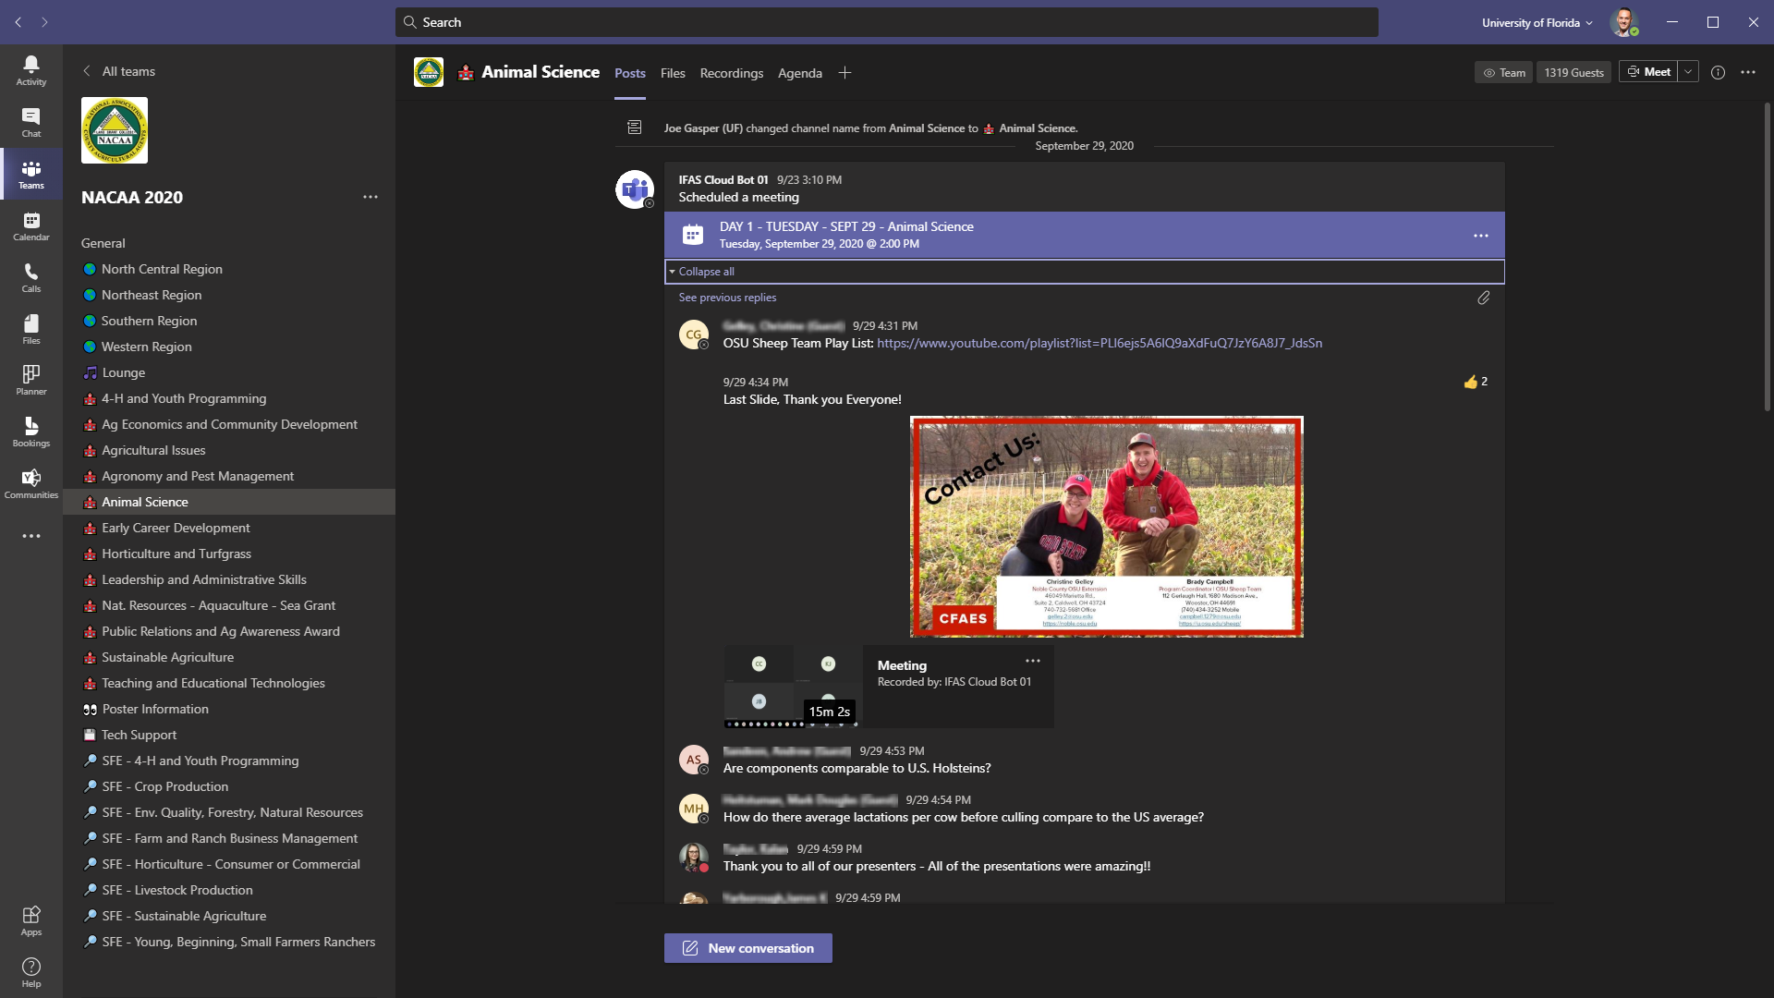
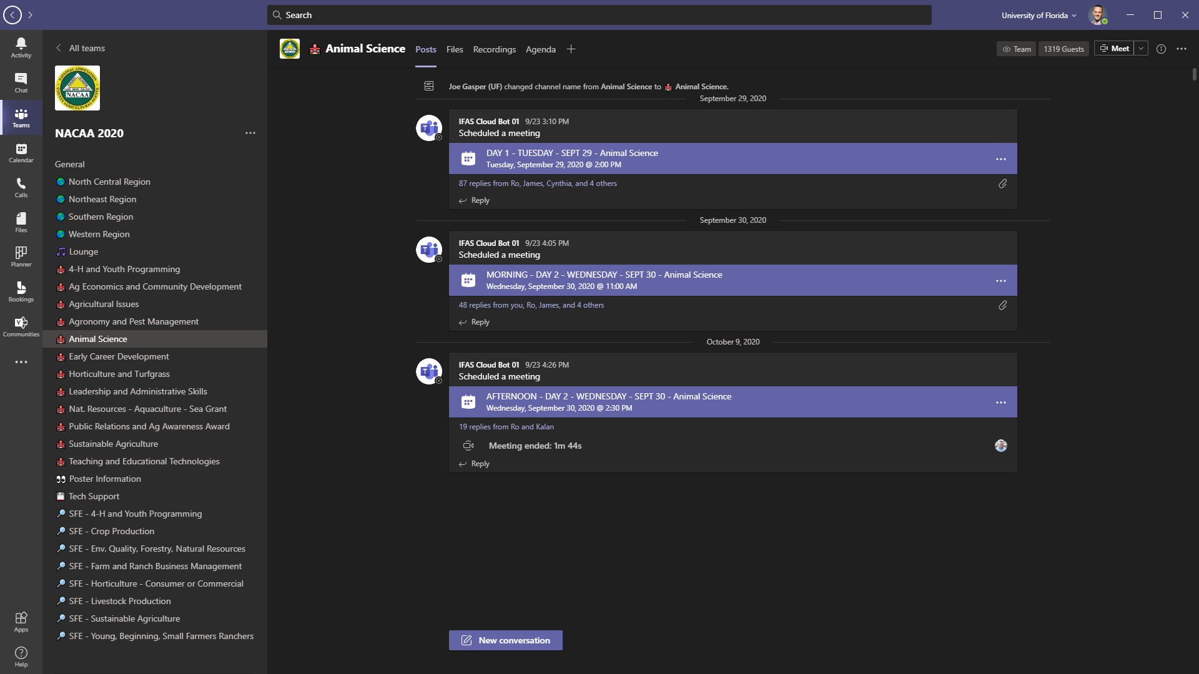
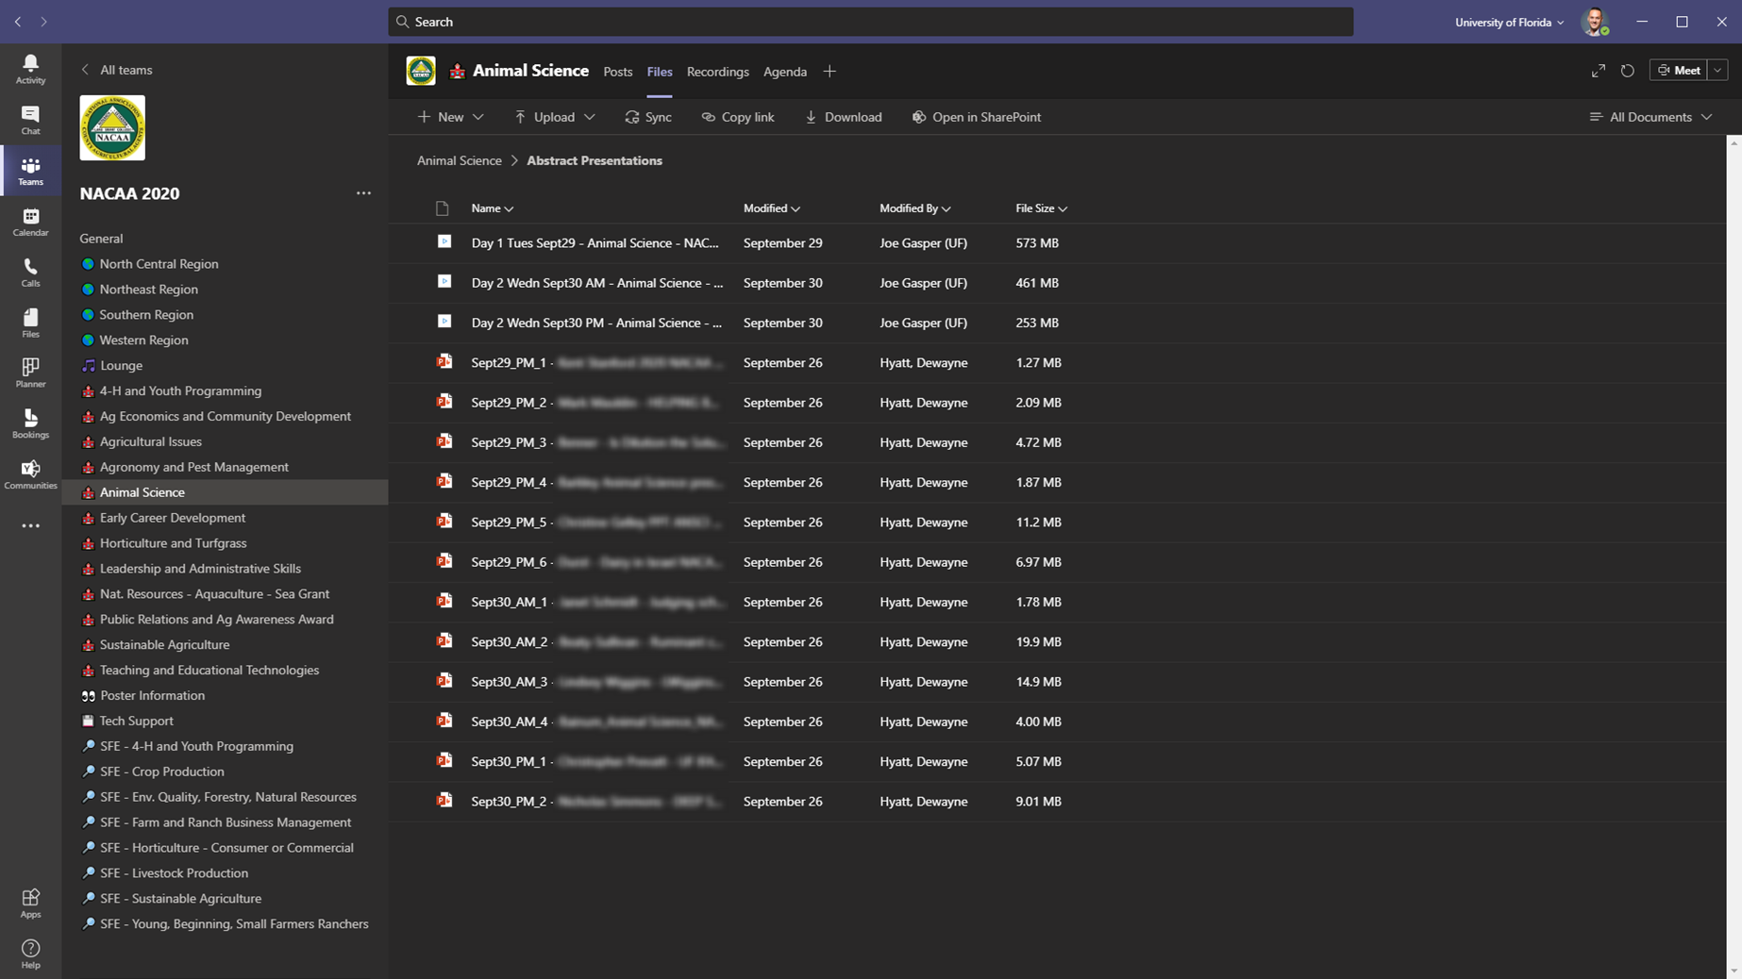
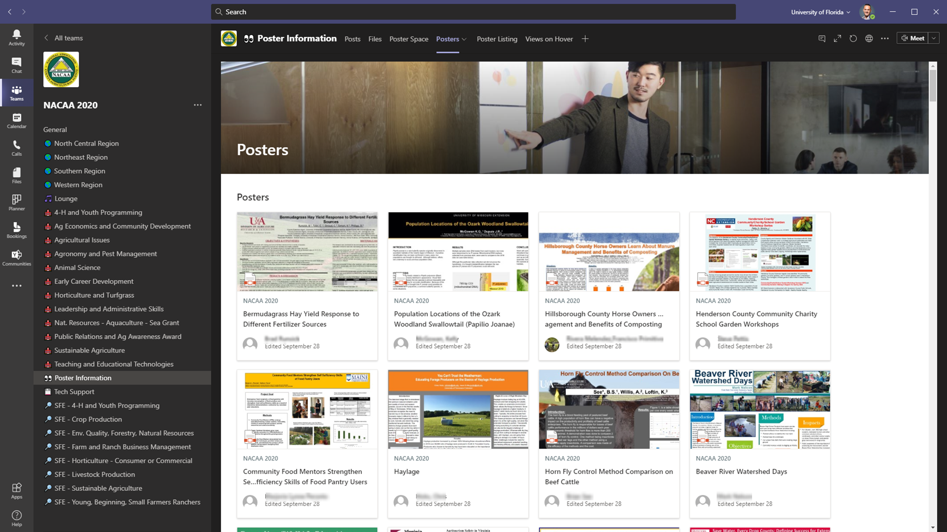
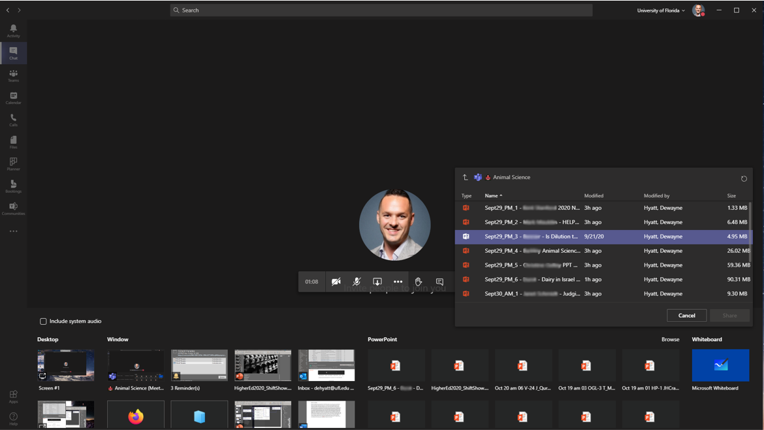
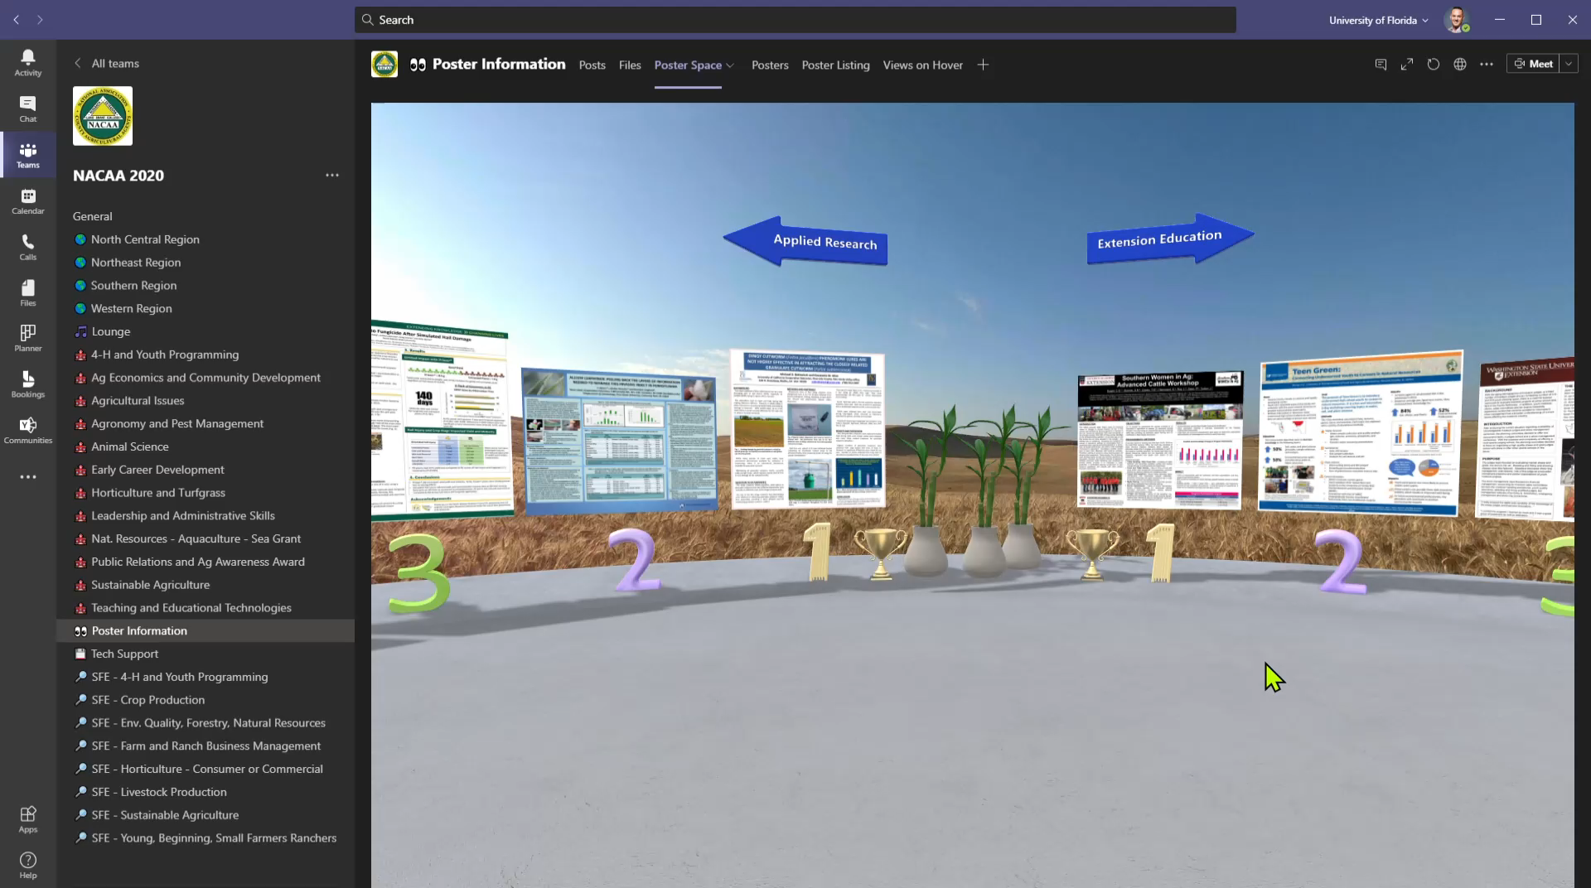
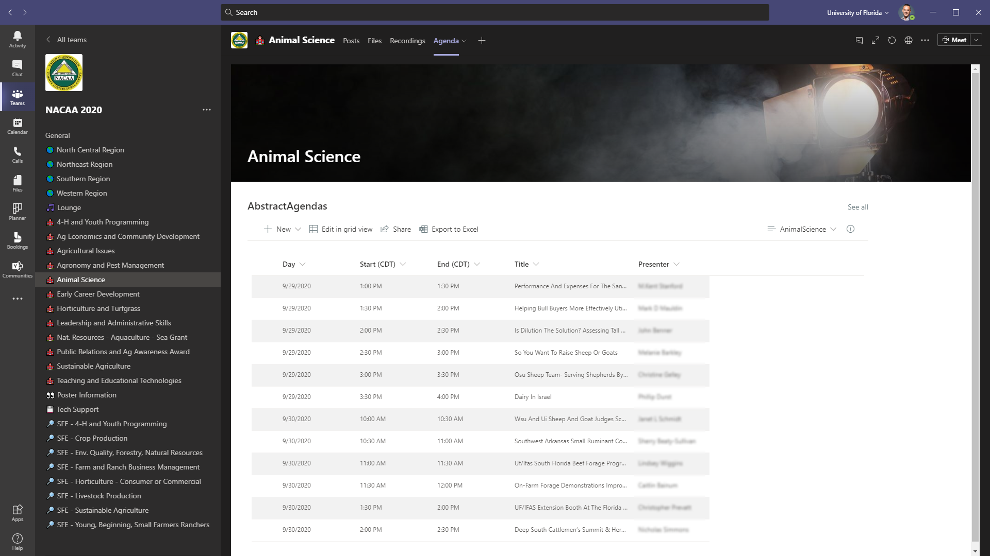
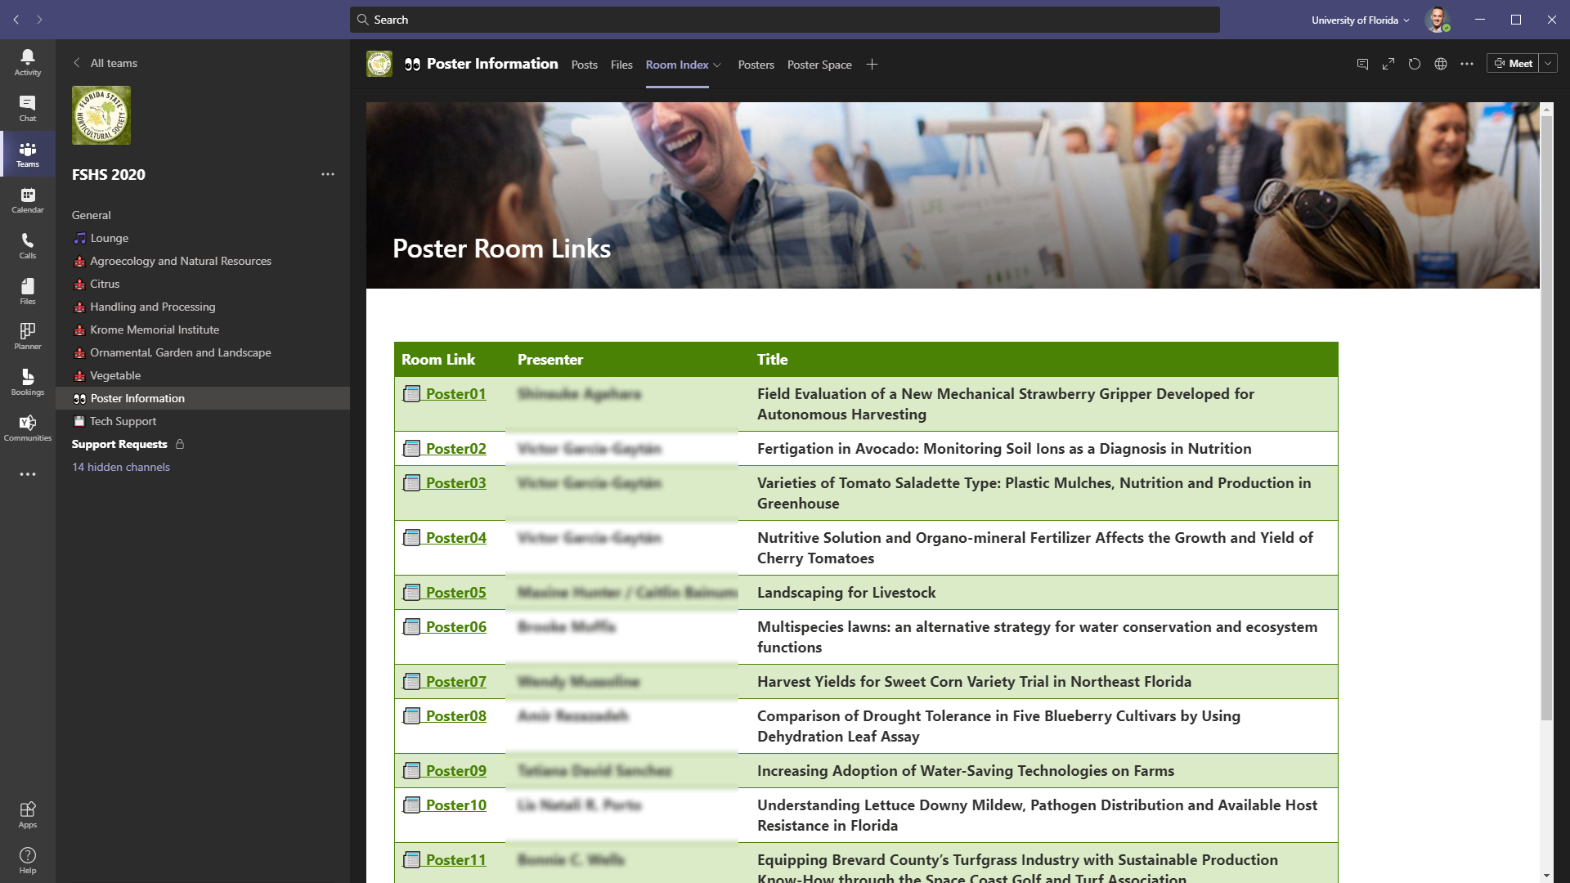
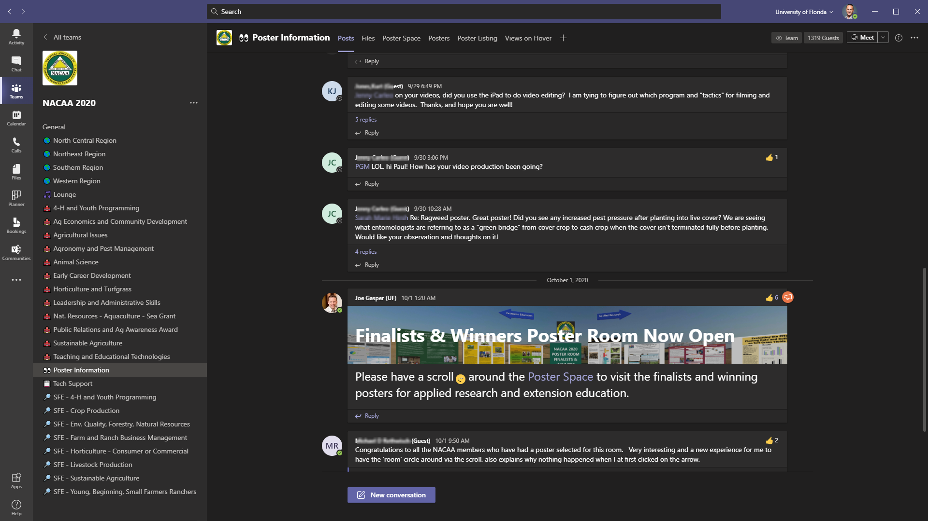
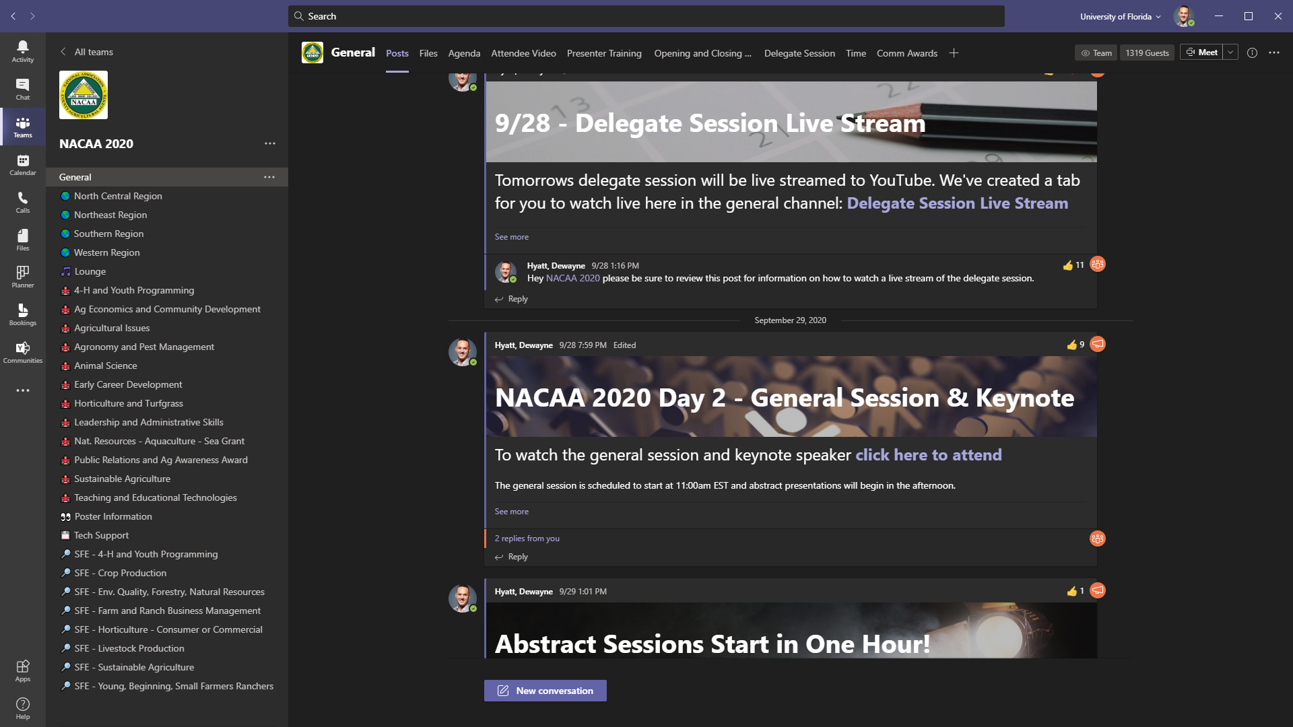
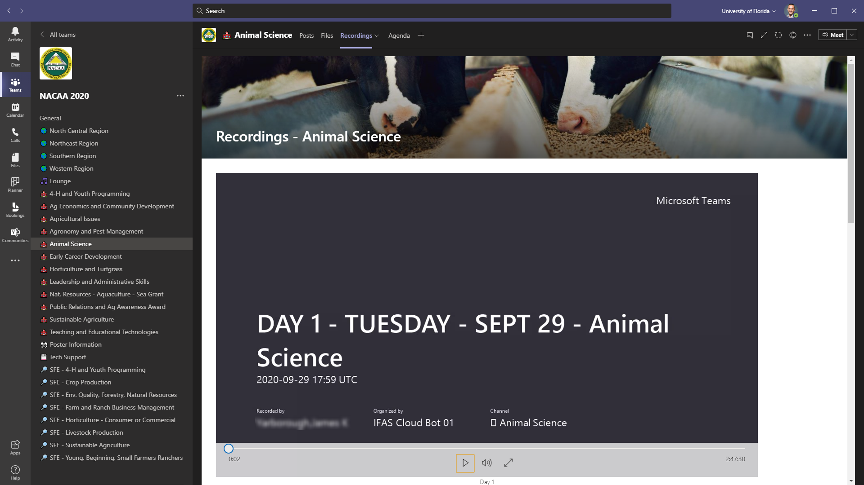
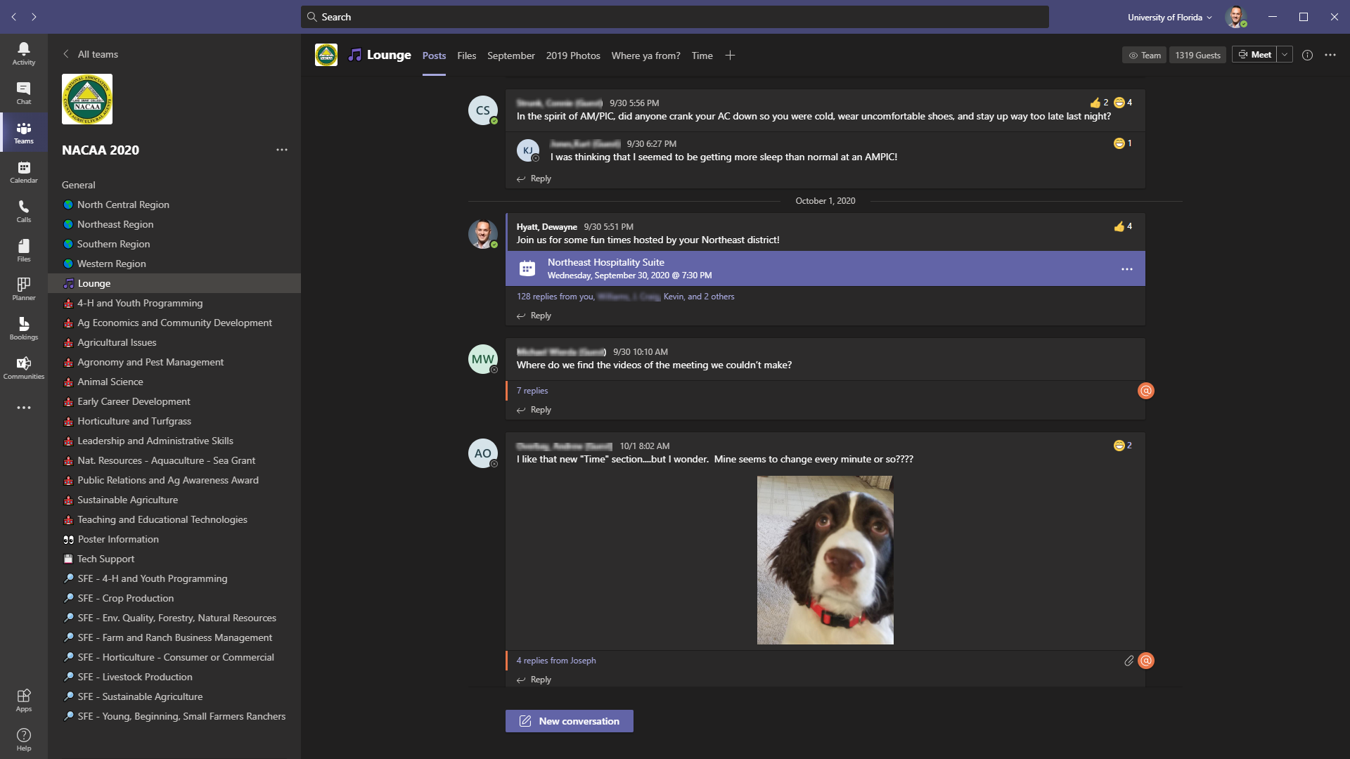
The “Virtual Venue”
All content is in a single place
Notes:
A brief overview of a virtual venue in Teams.
Where do to we talk about how tracks, sub-organizations, regions, etc. lead to channels/rooms?

Slide 7
Why Teams?
The “Virtual Venue”
All content is in a single place
Clear conference structure

Slide 8
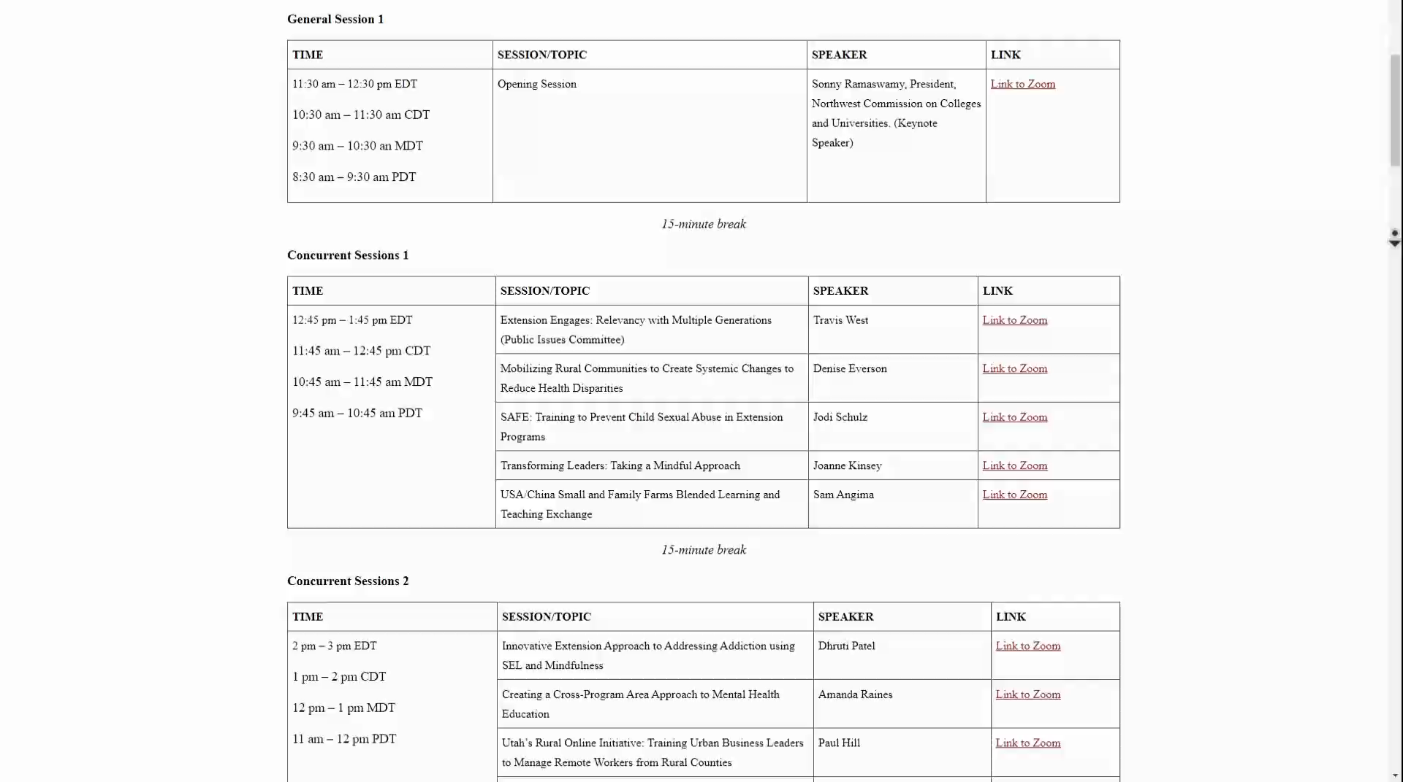
The “Virtual Venue”
All content is in a single place
Clear conference structure
Notes:
JOE
This seems to be a not uncommon setup for an online academic conference – this is a nicely formatted, long, scrolling page of links.
Each one of those links requires individual registration – because of security.
Say you’re interested in 3 tracks over 3 days, and some of a 4th track – lots of registrations.
With Microsoft Teams, the meetings can be contained inside the event team.
And for the attendee experience, this also means there can be a single registration process – like with an online event service or we’ll MS Forms.
Users don’t have to go search their email every day, or find that web page link, they're not looking for that PDF attachment to find the agenda and links to join meetings.
Instead of using several apps or windows to attend a session the event can be fully contained within Teams which can lead to a consist, repeatable, memorable experience for the attendee.

Slide 9
Why Teams?
The “Virtual Venue”
All content is in a single place
Clear conference structure
No transient meeting silos

Slide 10
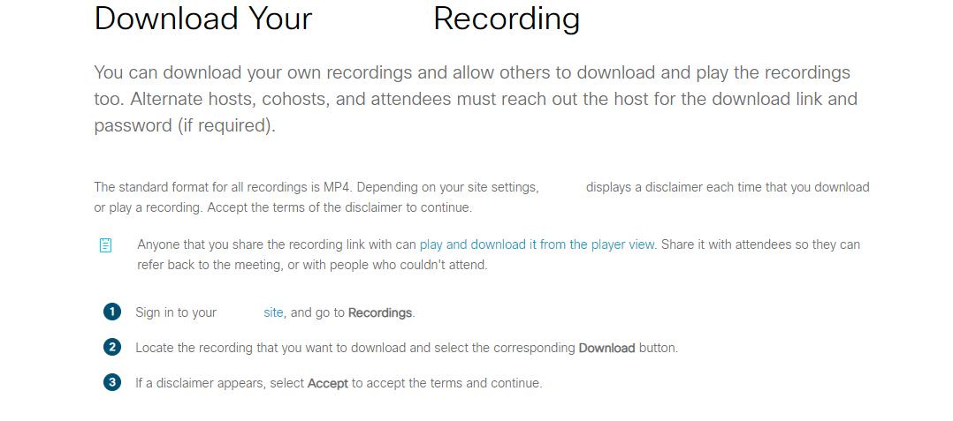
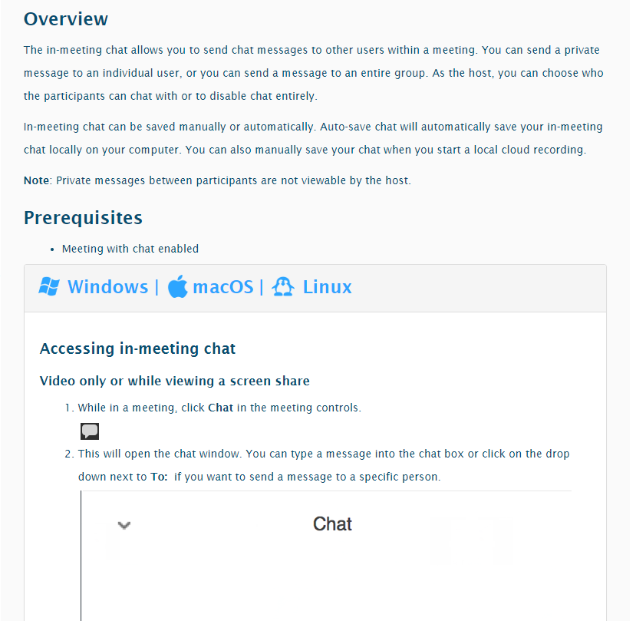
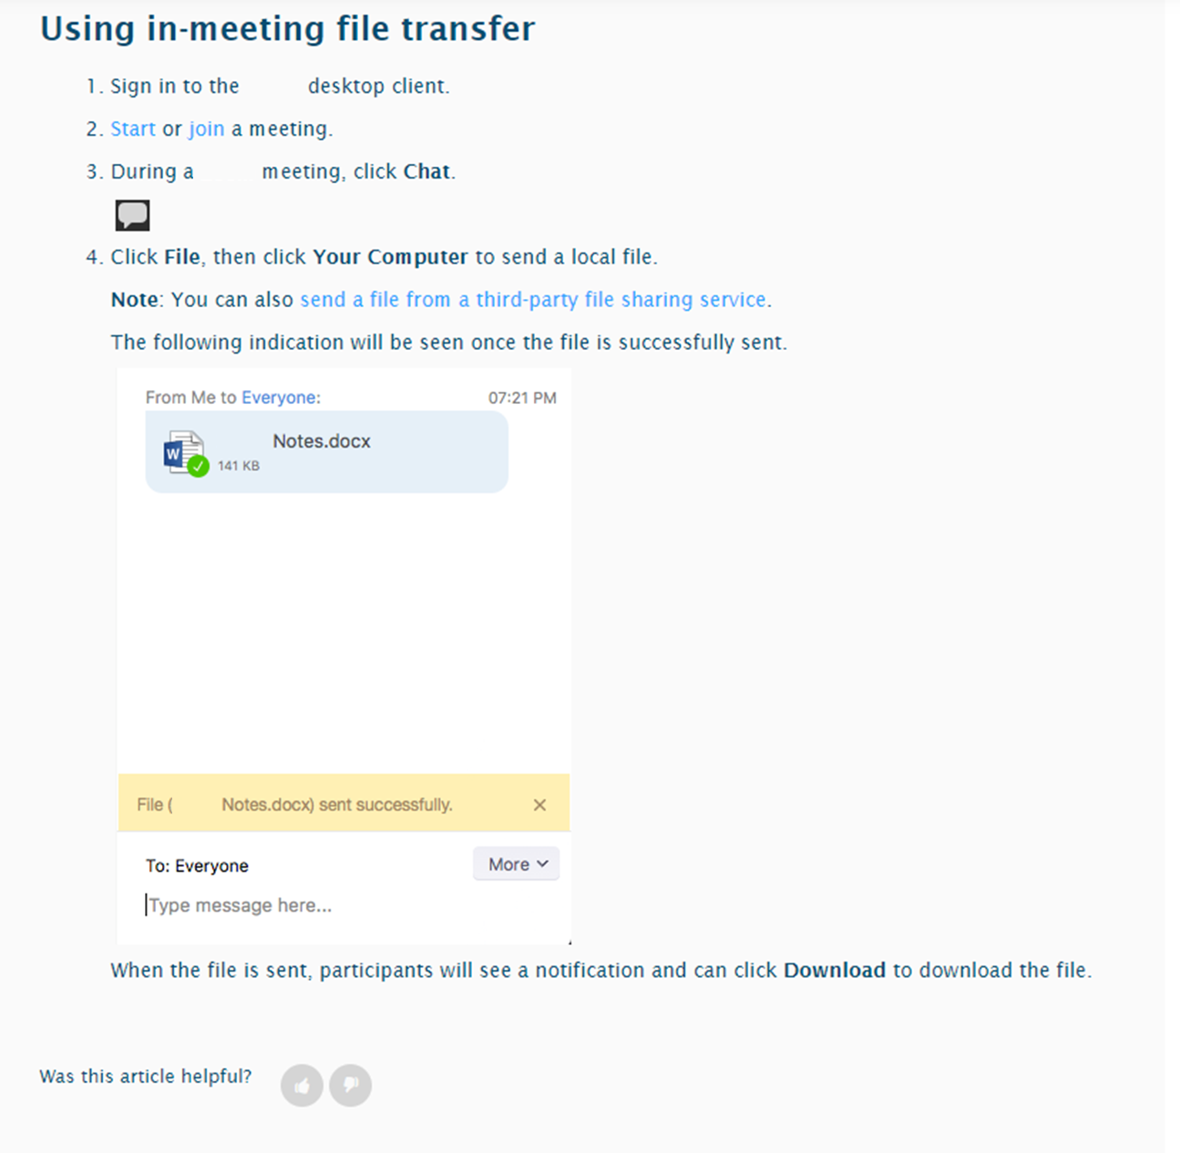
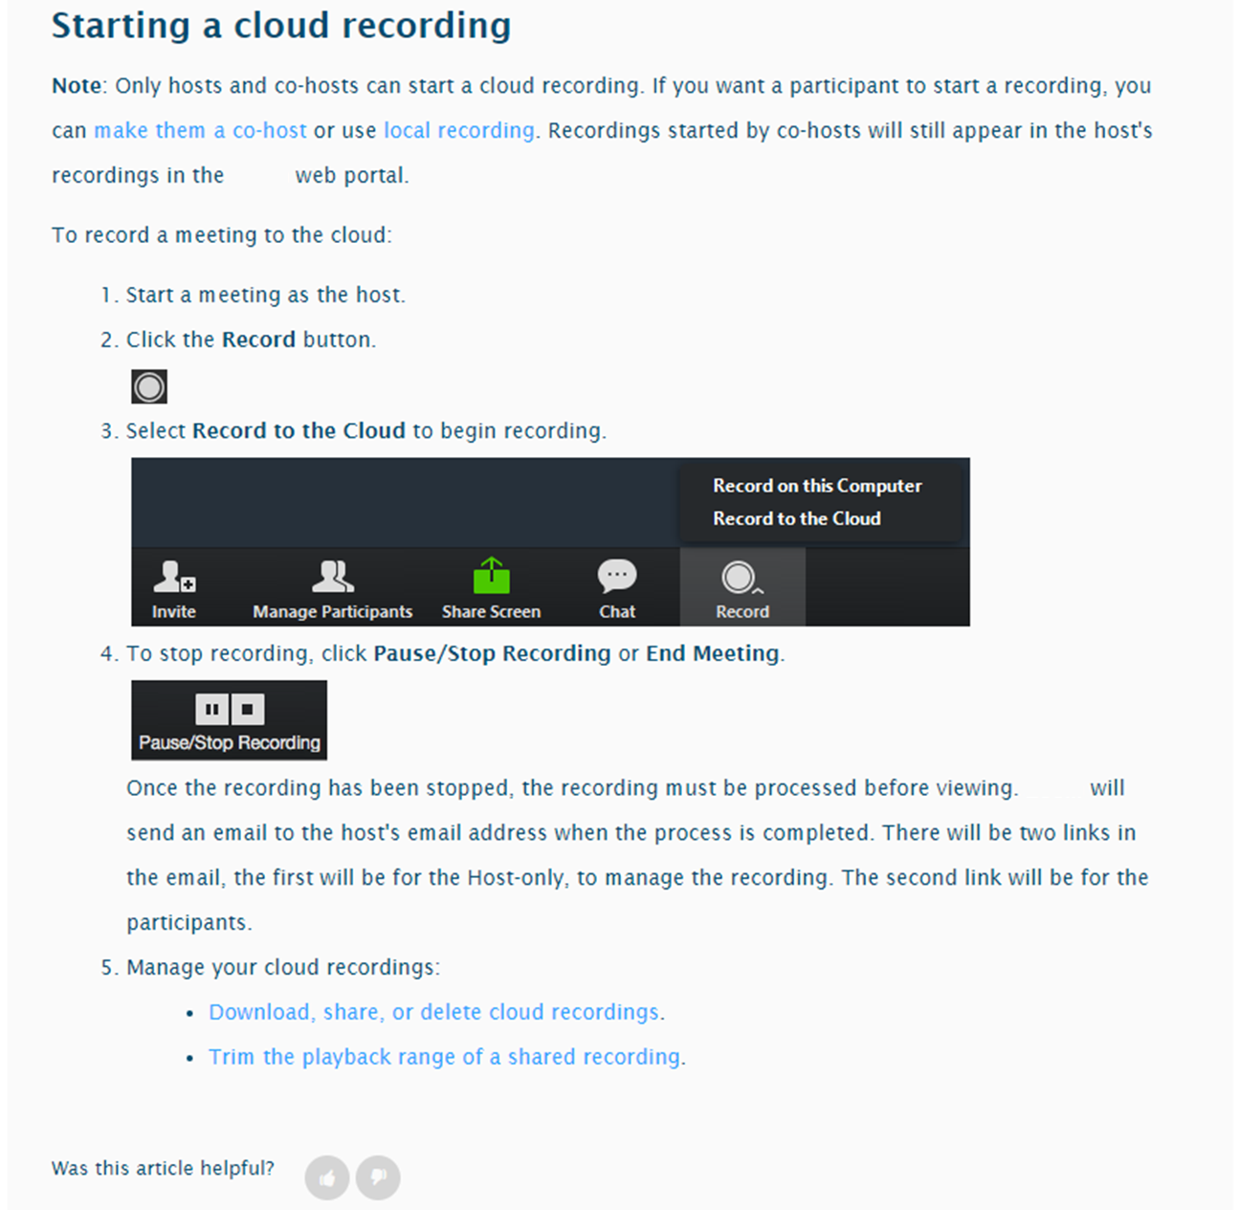
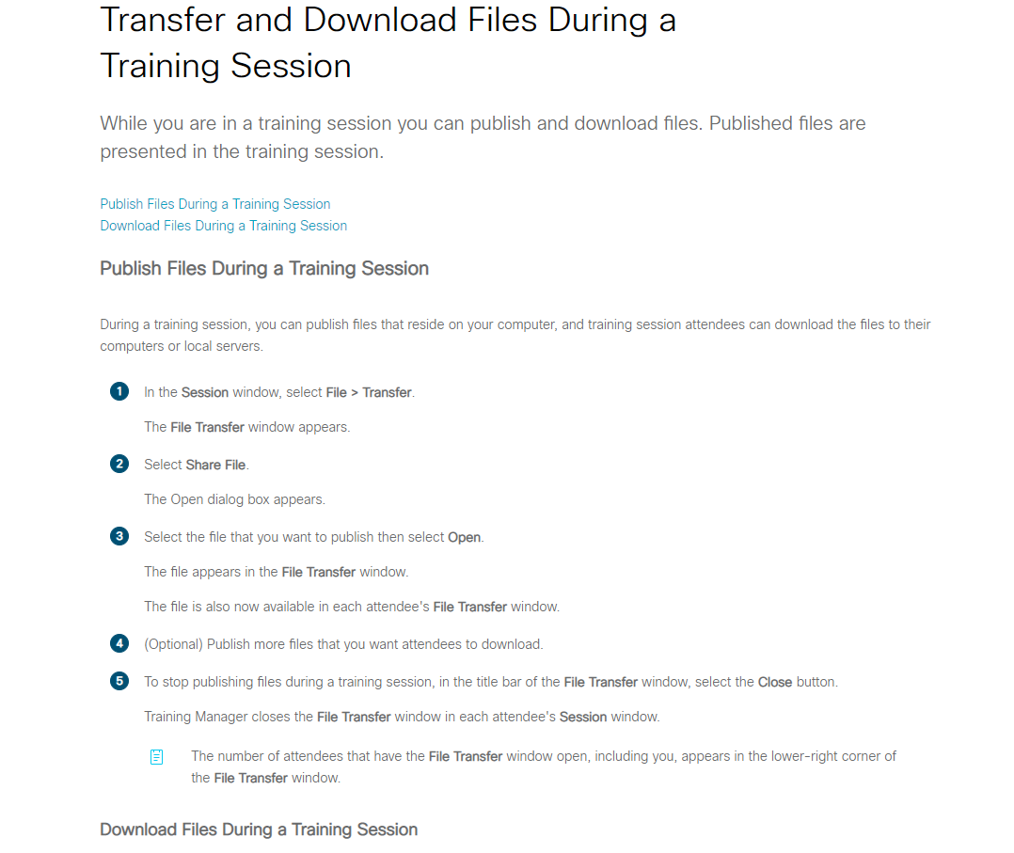
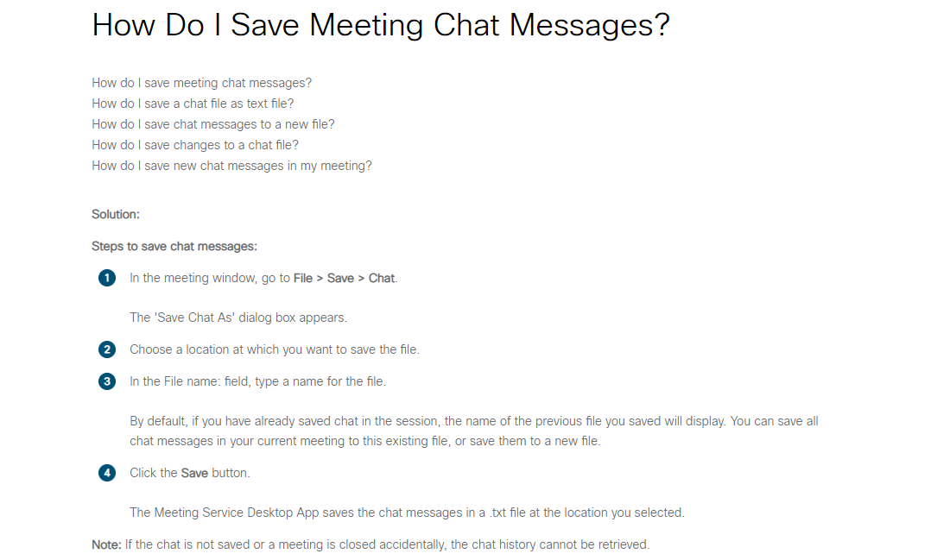
The “Virtual Venue”
All content is in a single place
Clear conference structure
No transient meeting silos
Notes:
Stand alone meetings are just that…. A meeting that is not connected to any other centralized system. It’s an island. If your conference has 40 meetings and you schedule 40 meetings you’ve created 40 islands or silos.
This means 40 recordings to find/share, copies of files generated and transferred inside of a meeting chat that you probably have to download before you end the meeting otherwise it could be lost.
An attendee can’t search across all the meetings, the chat, and content share – the knowledge is not anchored to a centralized place.

Slide 11
Why Teams?
The “Virtual Venue”
All content is in a single place
Clear conference structure
No transient meeting silos
No time limit on engagement
Notes:
DEWAYNE
JOE Posters – taking pictures.

Slide 12
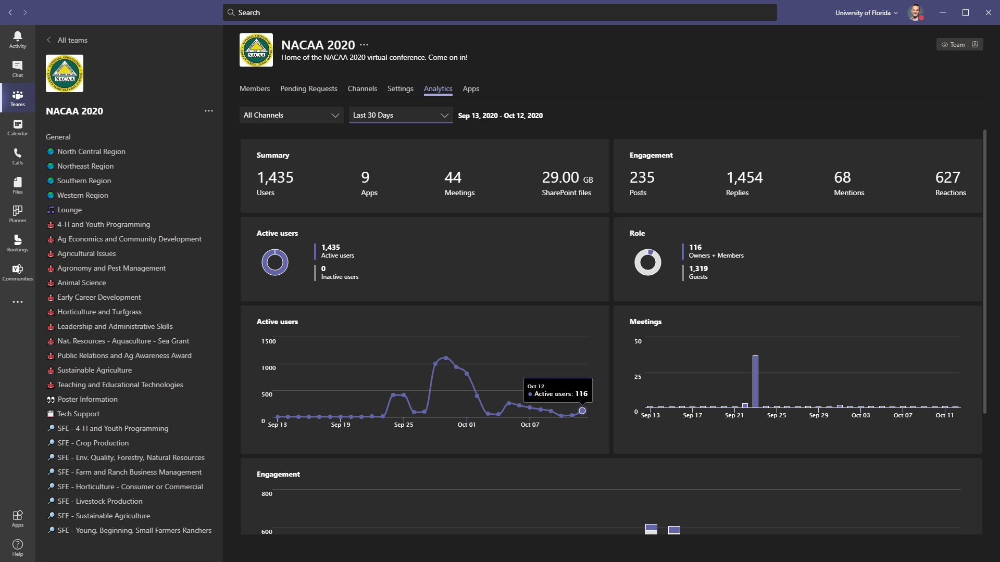
The “Virtual Venue”
All content is in a single place
Clear conference structure
No transient meeting silos
No time limit on engagement

Slide 13
The “Virtual Venue”
All content is in a single place
Clear conference structure
No transient meeting silos
No time limit on engagement

Slide 14
Why Teams?
The “Virtual Venue”
All content is in a single place
Clear conference structure
No transient meeting silos
No time limit on engagement
Free for education

Slide 15
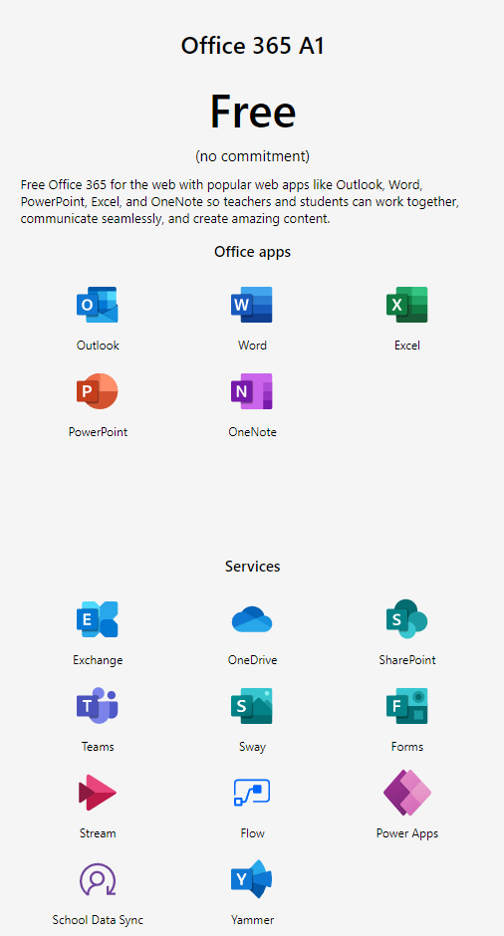
Free
Notes:
DEWAYNE

Slide 16
Free
Free
Notes:
JOE
We’ve seen vendors charging $25K for 12-hour rental of an online conference system.
Sure they are providing a good service, but at the end of those 12 hours…
Poof, all that knowledge and experience is gone.

Slide 17
Why Teams?
Notes:
DEWAYNE
So these have been some of the reasons we use Teams for online conferences.
Let’s look into how we do it.

Slide 18
How Teams?

Slide 19
How Teams?
Building a Virtual Venue

Slide 20
How Teams?
Building a Virtual Venue
Understand stakeholder goals

Slide 21
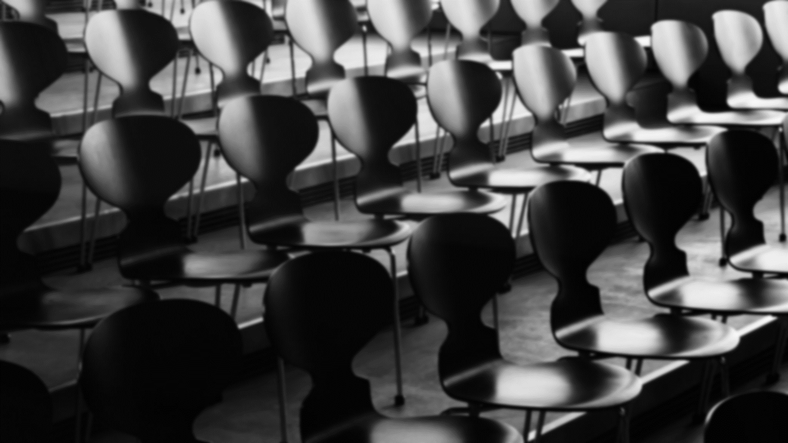
Building a Virtual Venue
Understand stakeholder goals
Things to consider:
How long has this event been happening?
How is the organization structured?
What are previous attendance numbers?
Are attendees primarily internal or external?
Virtual posters? How many? Meet the authors?
Do we expect 300+ in a session?
General session? Guest keynote speaker?
Any pre-recorded videos to play?
How Teams?
Notes:
DEWAYNE
Attendees internal/external?
Number of attendees?
Meet the author poster sessions?
How many posters?
Keynote with guest speaker?
Opening/closing sessions?
Concurrent sessions? – how many facilitators
Prepared video to share?
Live polls or surveys?
JOE?
Learn about the traditions of the conference to understand common functions, traditional components, common learning tracks, organization structure, etc.

Slide 22
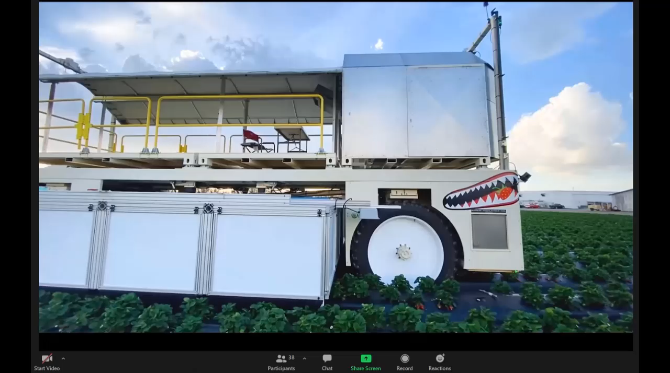
How Teams?
Building a Virtual Venue
Understand stakeholder goals
Notes:
DEWAYNE

Slide 23
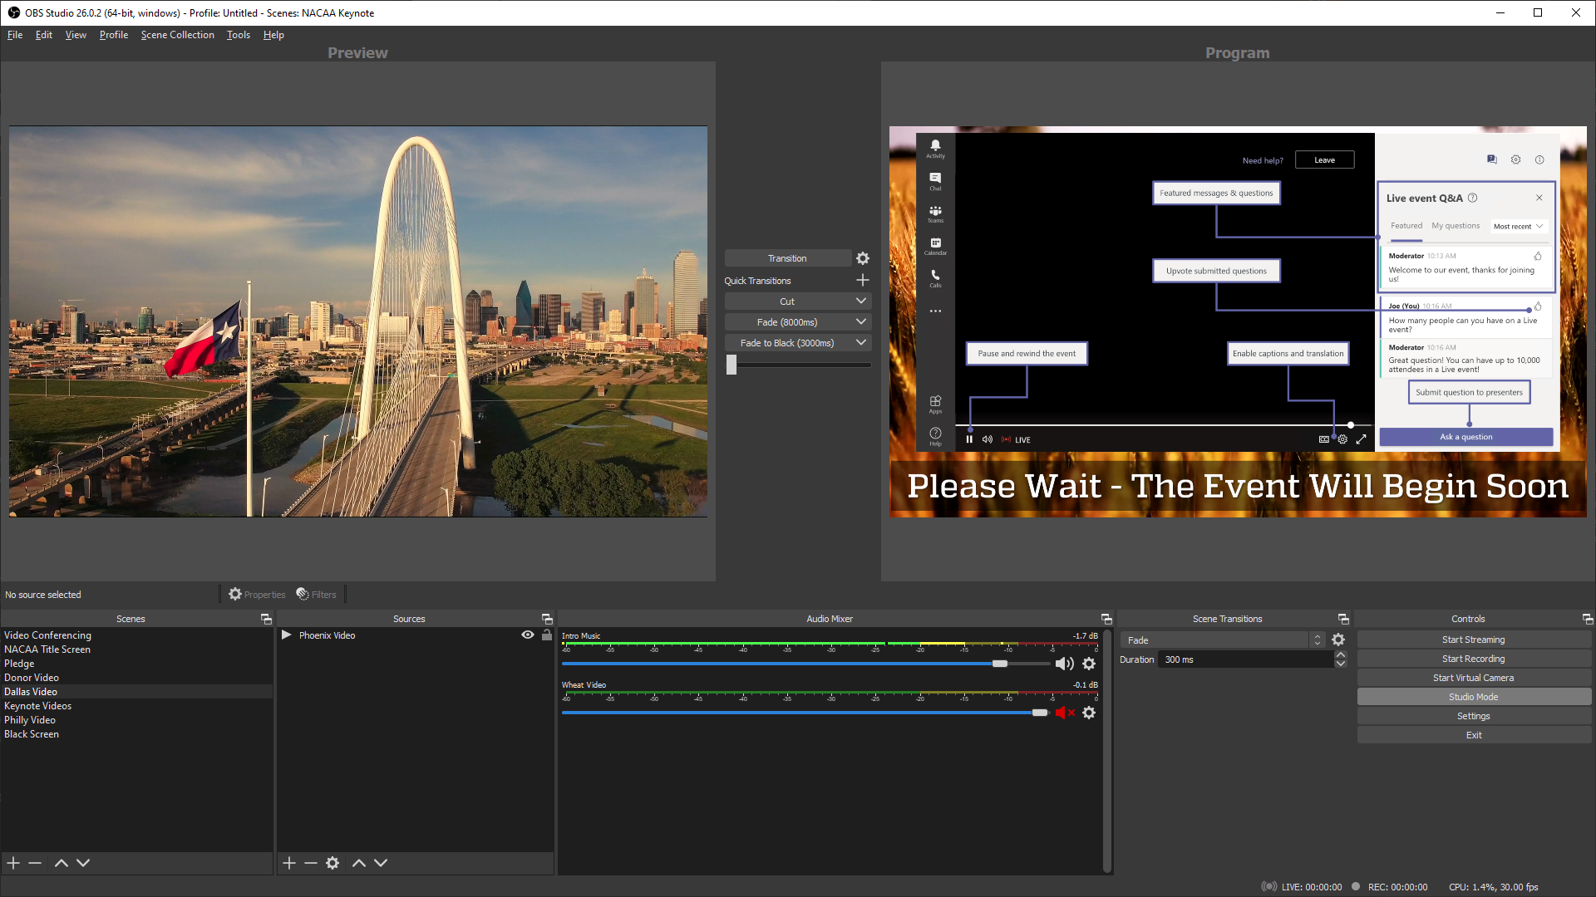
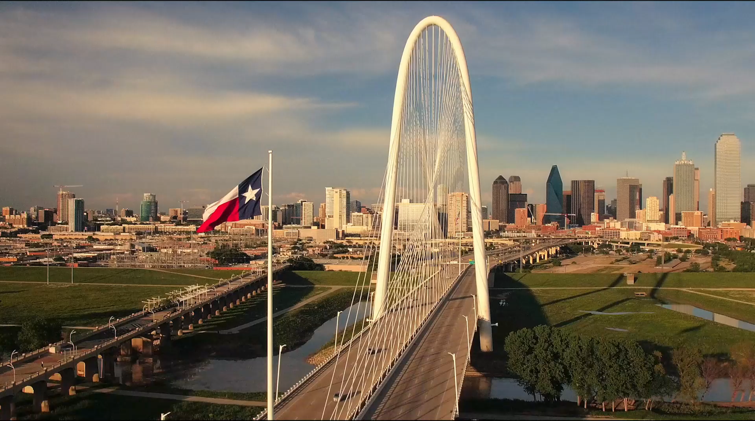
How Teams?
Building a Virtual Venue
Understand stakeholder goals
Notes:
DEWAYNE

Slide 24
How Teams?
Building a Virtual Venue
Understand stakeholder goals
Notes:
DEWAYNE
A nice “trick” is to use your webcam feed to stream video. Webcam feeds come through at a much higher frame rate than a screen share so they will look less choppy.
OBS v26 has a virtual camera plugin out of the box. Set Teams to use this virtual plugin and then configure scenes in OBS with your video content.
To route audio from the OBS video source into Teams you will need a virtual audio cable. We use VB-Cable. Configure this as your audio monitoring device in OBS and then configure each source video to output back to this monitor under advanced audio properties. Then set your mic in Teams to the VB-Cable output.

Slide 25
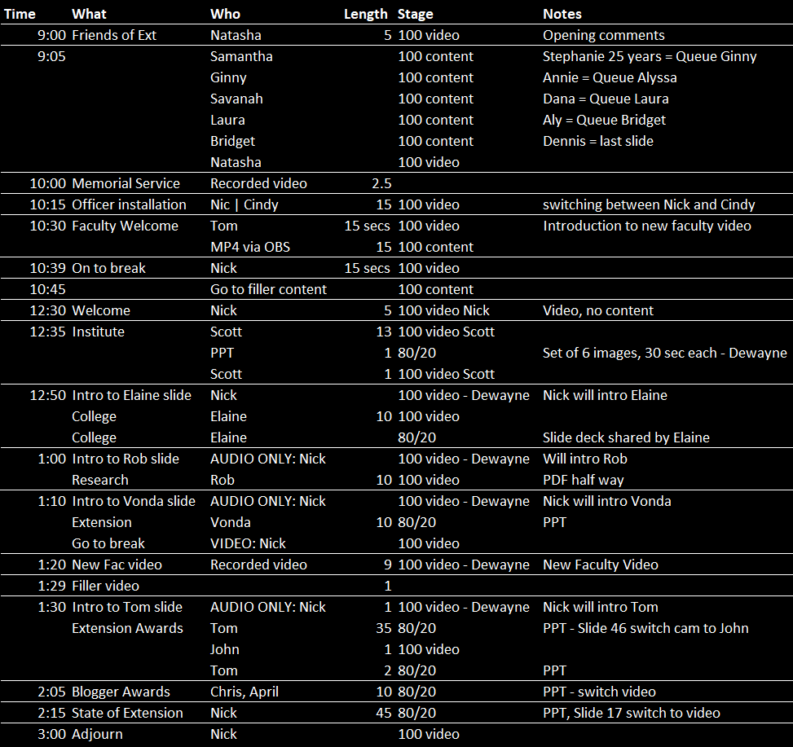
How Teams?
Building a Virtual Venue
Understand stakeholder goals
Notes:
JOE
Technical tip – person tip
Another tip for successful live events is to have a detailed script to smooth the transitions between speakers.
When you have 45 transitions scheduled – you need write them down. As a producer it helps you queuing up the next content and who to ping in the chat as next speaker.
Once get access to the recordings, be sure to watch Jeremy Miller’s session from earlier in the week on Live Events for a deeper dive.

Slide 26
How Teams?
Building a Virtual Venue
Understand stakeholder goals
Build a demo team

Slide 27
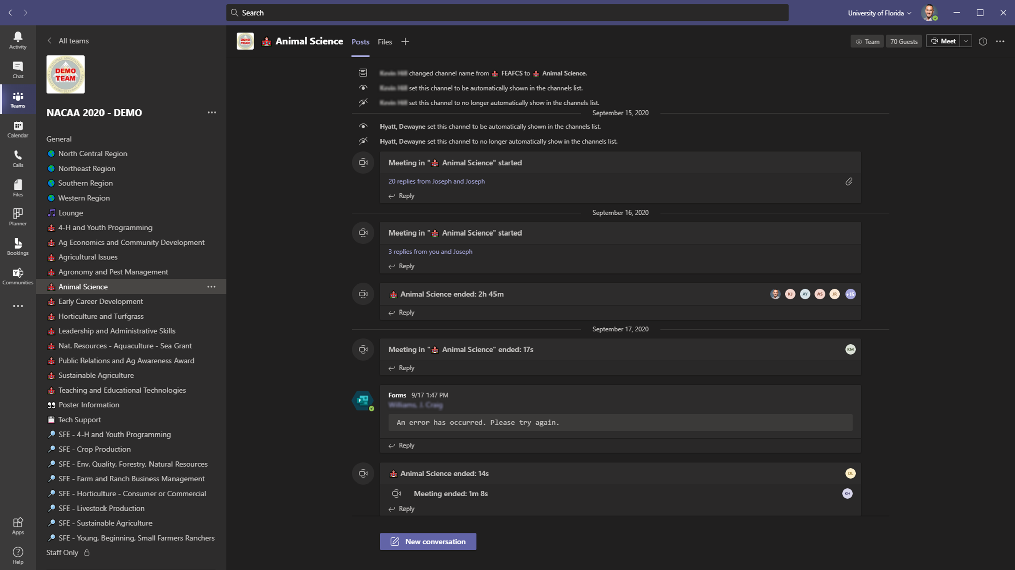
Building a Virtual Venue
Understand stakeholder goals
Build a demo team
Notes:
DEWAYNE
Set description - attendees will see this in email invite
General channel - moderated - this is your PA system, LCD screens. Post announcements to attendees - user the Announcement post type. Use custom backgrounds. Make it engaging.
Setting channels to show - only get 10 for all attendees - choose wisely. Maybe don't show some if not useful for all attendees.
Watch the length of the team name and channel names - don't get cut off.
Emojis for channel names - create for visual and sorting - do it after first creation.
Standard channels - Lounge, Tech Support.
Build channels around tracks and knowledge focus. You may have region-based channels, or poster/abstract channels
Channel moderation - understand difference between General and other channels.
Helpful to enable moderation to prevent fragmented conversations.
Turn on and post a welcome or reason post - maybe it's just a channel meeting post.
Prevents attendees from starting a Meet Now.
JOE
Consider a staff-only or presenters lounge using a private channel, where your event staff can communicate.

Slide 28
Use “DEMO” in team name and watermark team icon to reduce accidents 😃
Building a Virtual Venue
Understand stakeholder goals
Build a demo team
Use emojis in channel name to organize and group channels together. (Win + period to access emoji picker) 🥓🥓🐱‍🐉🐱‍🐉🌮🌮
Notes:
DEWAYNE
Don’t use emoji in original name. Name channel then add emoji after to see how they sort. Trial and error. Good luck.
It adds a nice touch for the attendees as it keeps similar use channels bunched together.

Slide 29
Work out channel names and settings with stakeholders to remove status message spam from showing in the production team.
Building a Virtual Venue
Understand stakeholder goals
Build a demo team
Notes:
EEWAYNE
Use demo team to get channel names finalized so that you name it right the first time in the production team.
Renaming channels is a mess on the backend since the connected folders in SharePoint currently don’t change.

Slide 30
Building a Virtual Venue
Understand stakeholder goals
Build a demo team
Have practice sessions with facilitators and “event staff” keeping production team channels nice and clean.
😥
Experiment and expose any potential “undesired behavior” (Like guests can’t respond to quick polls….)
Notes:
DEWAYNE

Slide 31
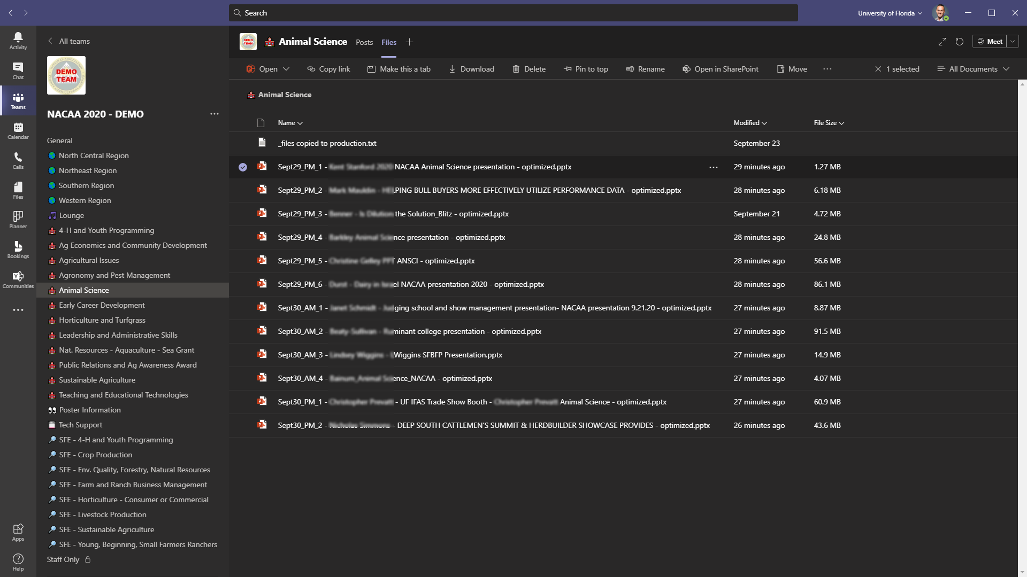

Building a Virtual Venue
Understand stakeholder goals
Build a demo team
Notes:
DEWAYNE

Slide 32
Building a Virtual Venue
Understand stakeholder goals
Build a demo team
Notes:
DEWAYNE
Place to collect PowerPoint files.
Check them for issues.

Slide 33
Building a Virtual Venue
Understand stakeholder goals
Build a demo team
Notes:
DEWAYNE

Slide 34
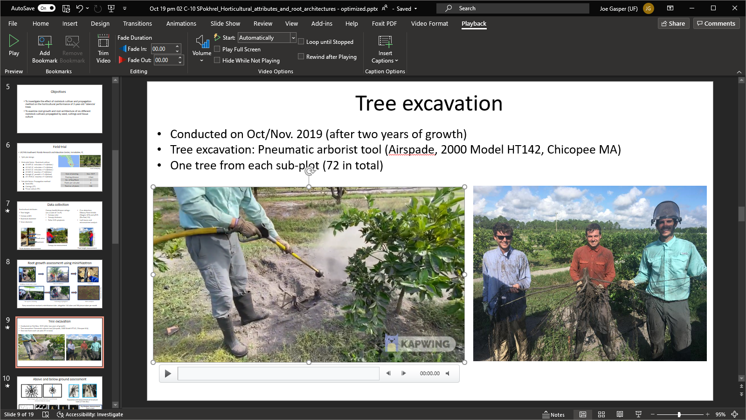
Building a Virtual Venue
Understand stakeholder goals
Build a demo team
Notes:
DEWAYNE
Set embedded videos to autoplay to ensure they work with PowerPoint Online.
Set volume to medium or mute.
JOE
A bonus of using PowerPoint sharing is the that hyperlinks on your slides are active for the attendees. So if you say provide a link to additional information or an extended youtube video, or maybe a link to a poll, the attendees can click right on the hyperlink in the slide.

Slide 35
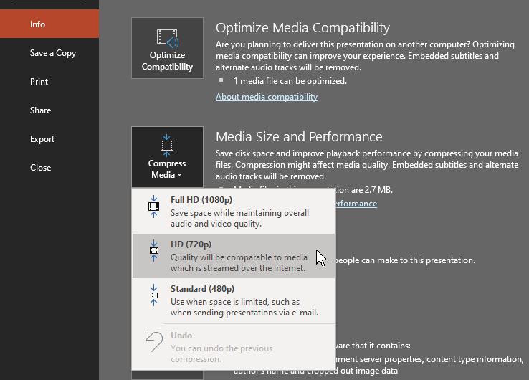
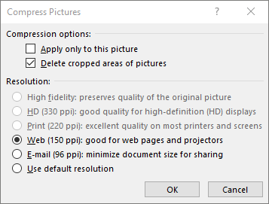
Building a Virtual Venue
Understand stakeholder goals
Build a demo team
Notes:
DEWAYNE

Slide 36
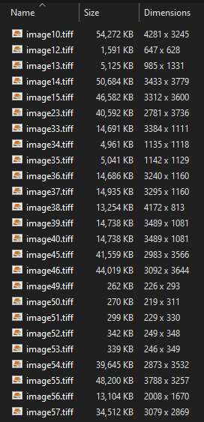
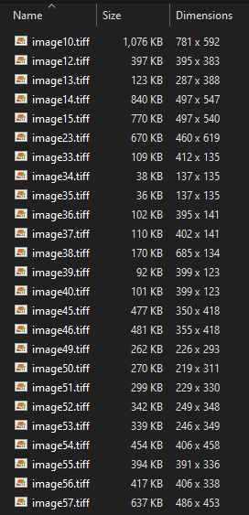
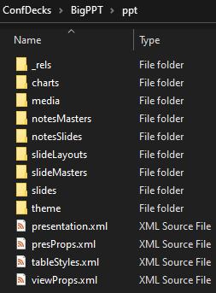
Large Media Hunting
unzip your PowerPoint
Building a Virtual Venue
Understand stakeholder goals
Build a demo team
Before: 519MB
After: 10.5MB
Notes:
JOE
2 cases – just curious – and a file we just couldn’t figure out why the file would not reduce down.
So you can “unzip” the PowerPoint file to see what the heck is going on.
Copy your PPTX file to a new document and then change its file extension to “.zip” and unzip that file.
Drill into the \ppt\media folder to see media content.
This one had 50MB 4K TIFFs – overkill for a web presentation.
Use Picture compress – 520MB becomes 11MB

Slide 37
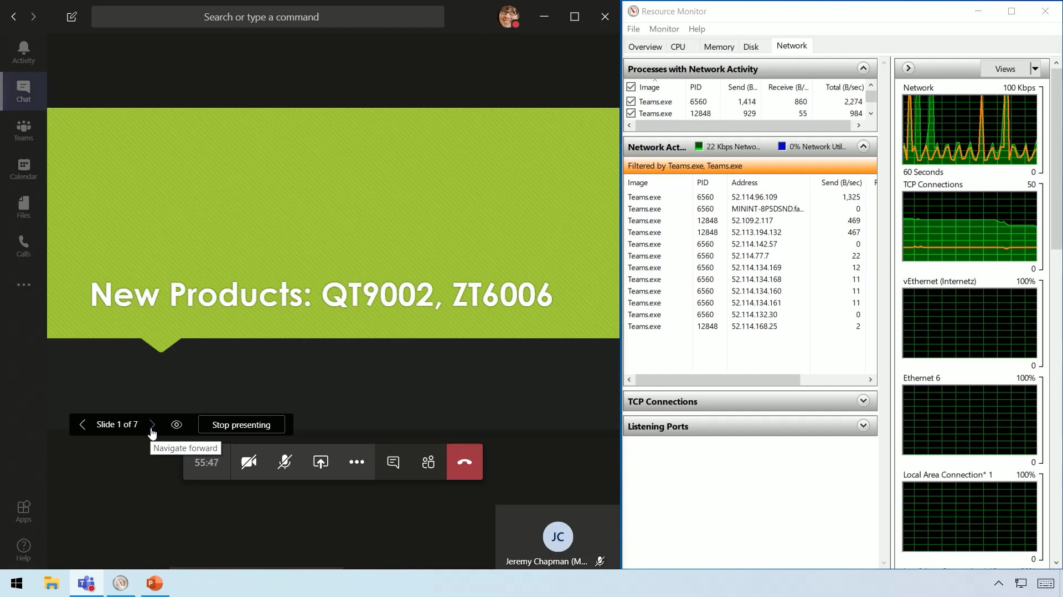
Building a Virtual Venue
Understand stakeholder goals
Build a demo team
Notes:
DEWAYNE

Slide 38
Building a Virtual Venue
Understand stakeholder goals
Build a demo team
aka.my/pptbandwidth
Notes:
DEWAYNE

Slide 39
How Teams?
Building a Virtual Venue
Understand stakeholder goals
Build a demo team
Train facilitators, moderators

Slide 40
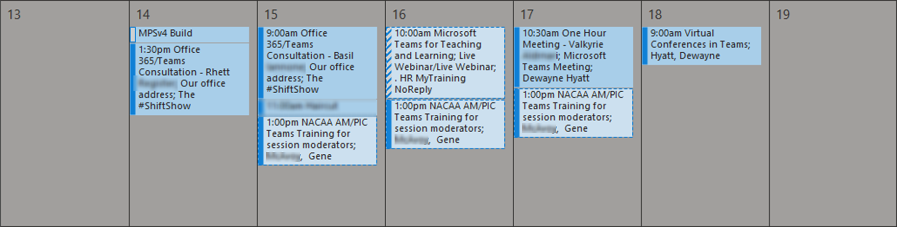
How Teams?
Building a Virtual Venue
Understand stakeholder goals
Build a demo team
Train facilitators, moderators
Notes:
DEWAYNE
Offer face to face (virtual) training multiple times. We’ve seen people that are invested in making sure they are comfortable with the moderation techniques.
Roles – share, promote, mute
JOE
We’re not training other IT, but faculty and extension agents – we’ve built a great army of facilitators and moderators than can run all these meeting smoothly.
And we really train them on the aspects of the PowerPoint sharing – and it’s really around the presenter’s experience. The meeting facilitator loads the PowerPoint decks for each presenter. The presenter just has to be trained on taking control of the slides – it’s really like they walk up on stage and we hand them a virtual clicker.
This also helps with the attendee experience. Some meeting sessions can run a few hours and have 15 back to back presenters – a lot of fumbling can go on with regular screen or app sharing.

Slide 41
How Teams?
Building a Virtual Venue
Understand stakeholder goals
Build a demo team
Train facilitators, moderators
Set attendee expectations

Slide 42
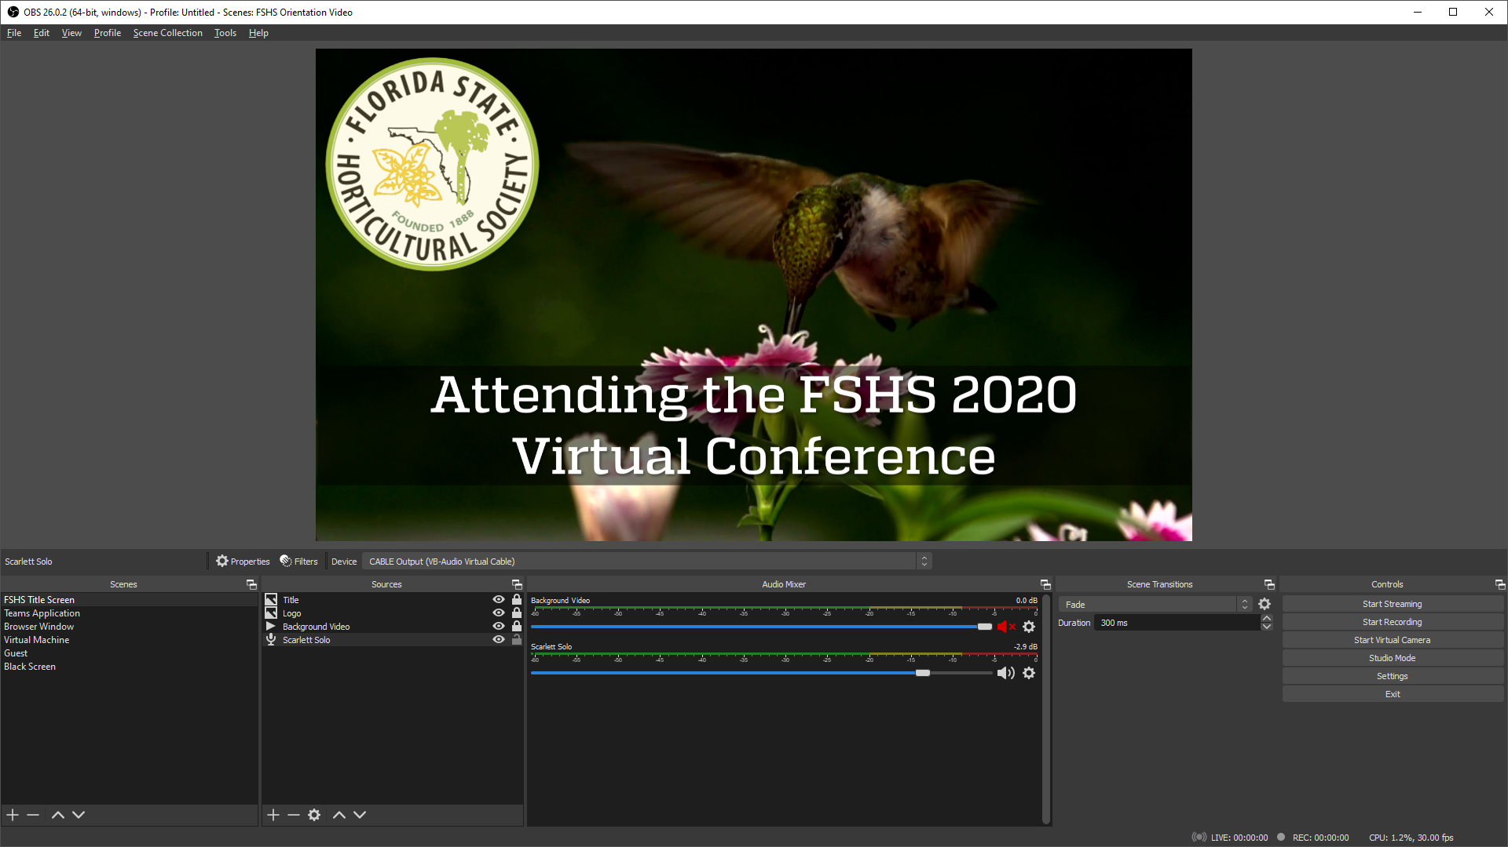
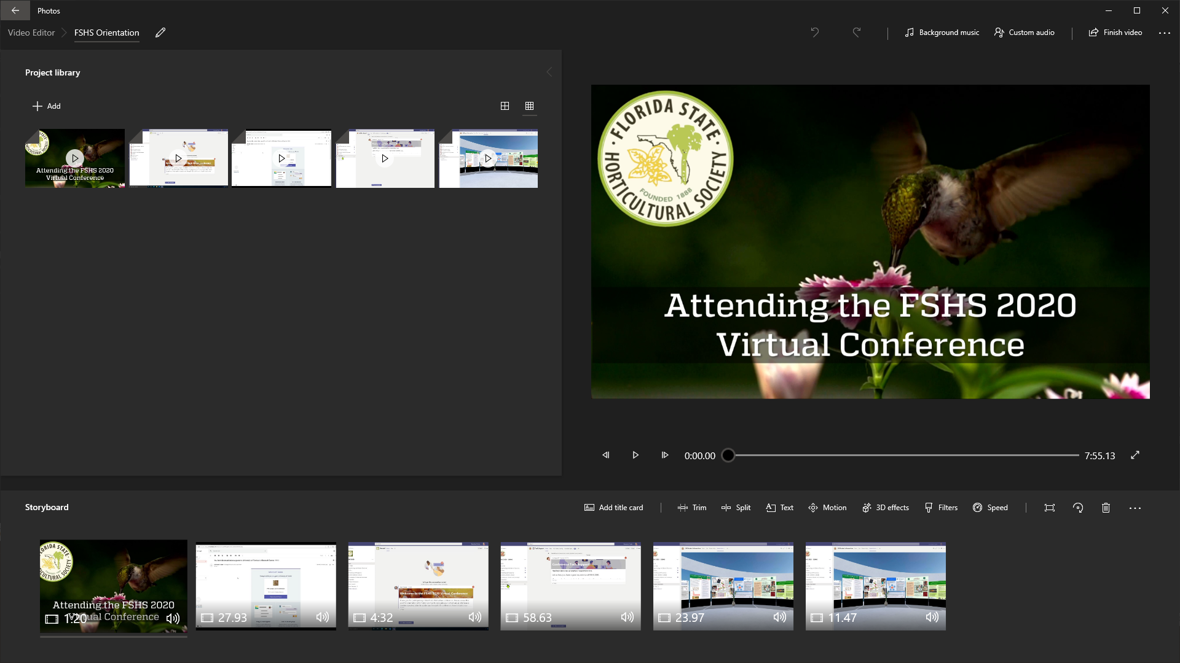
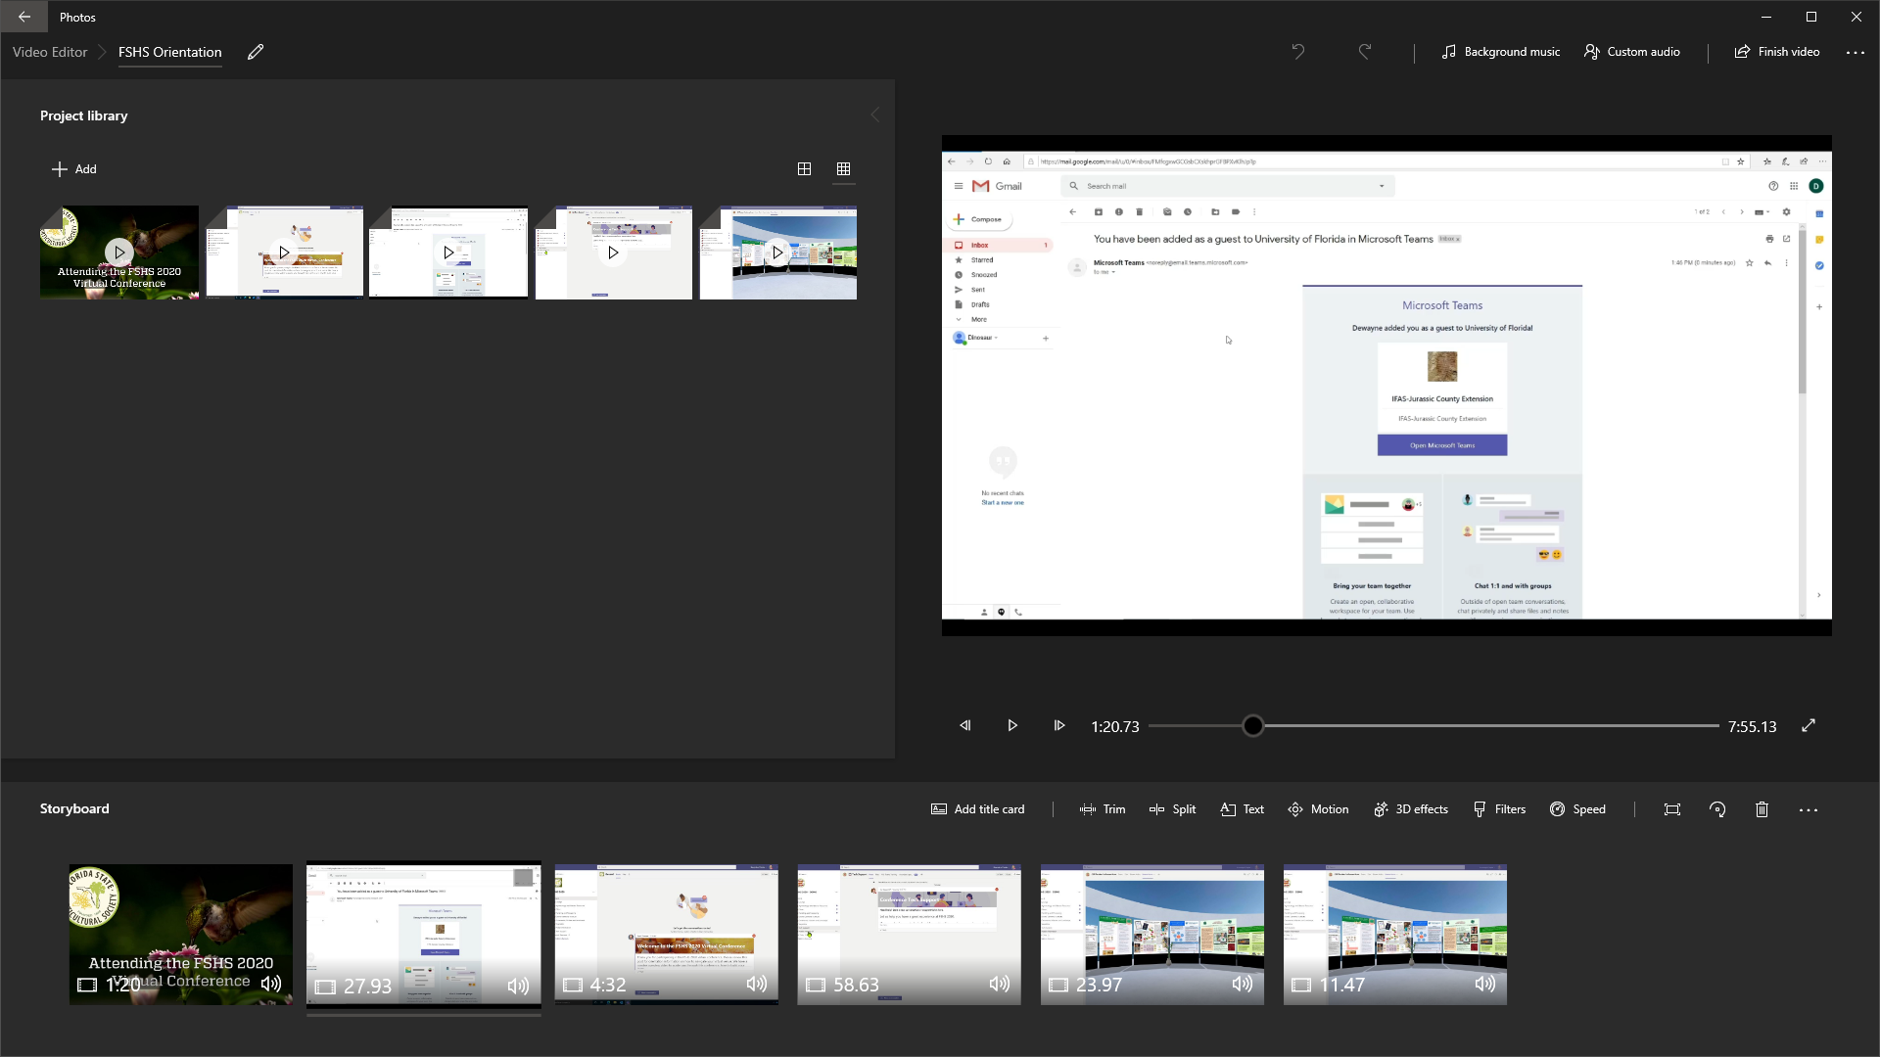
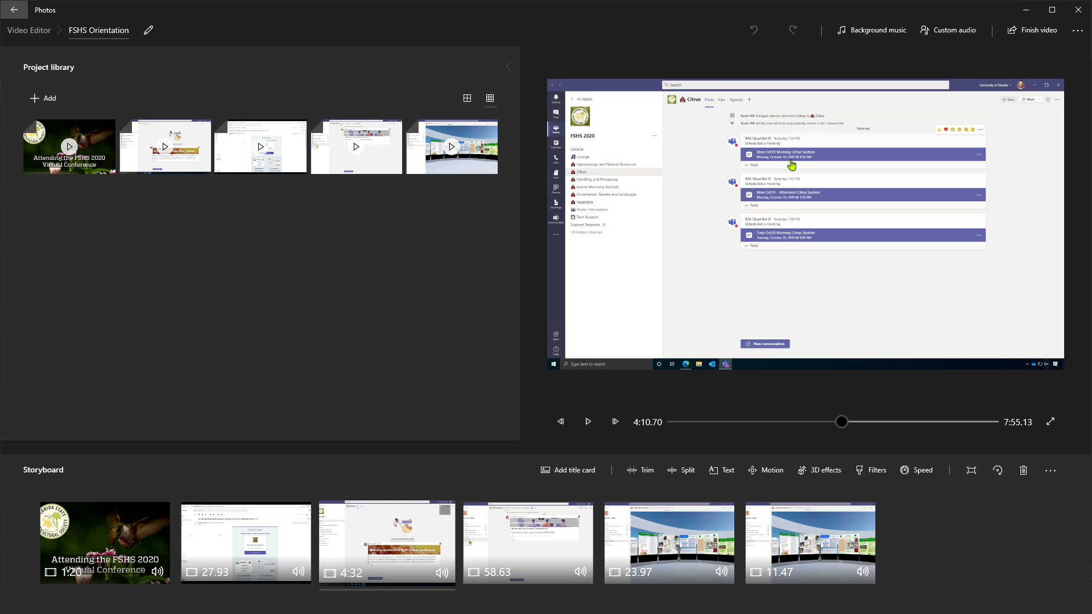
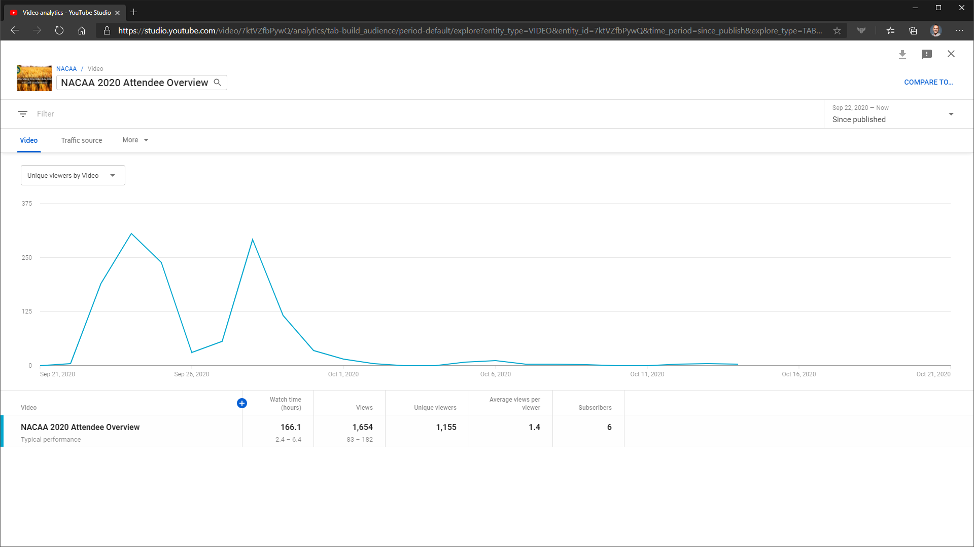
Building a Virtual Venue
Understand stakeholder goals
Build a demo team
Train facilitators, moderators
Set attendee expectations
Notes:
DEWAYNE
Covering attendee overview videos sent to attendees pre-conference.

Slide 43
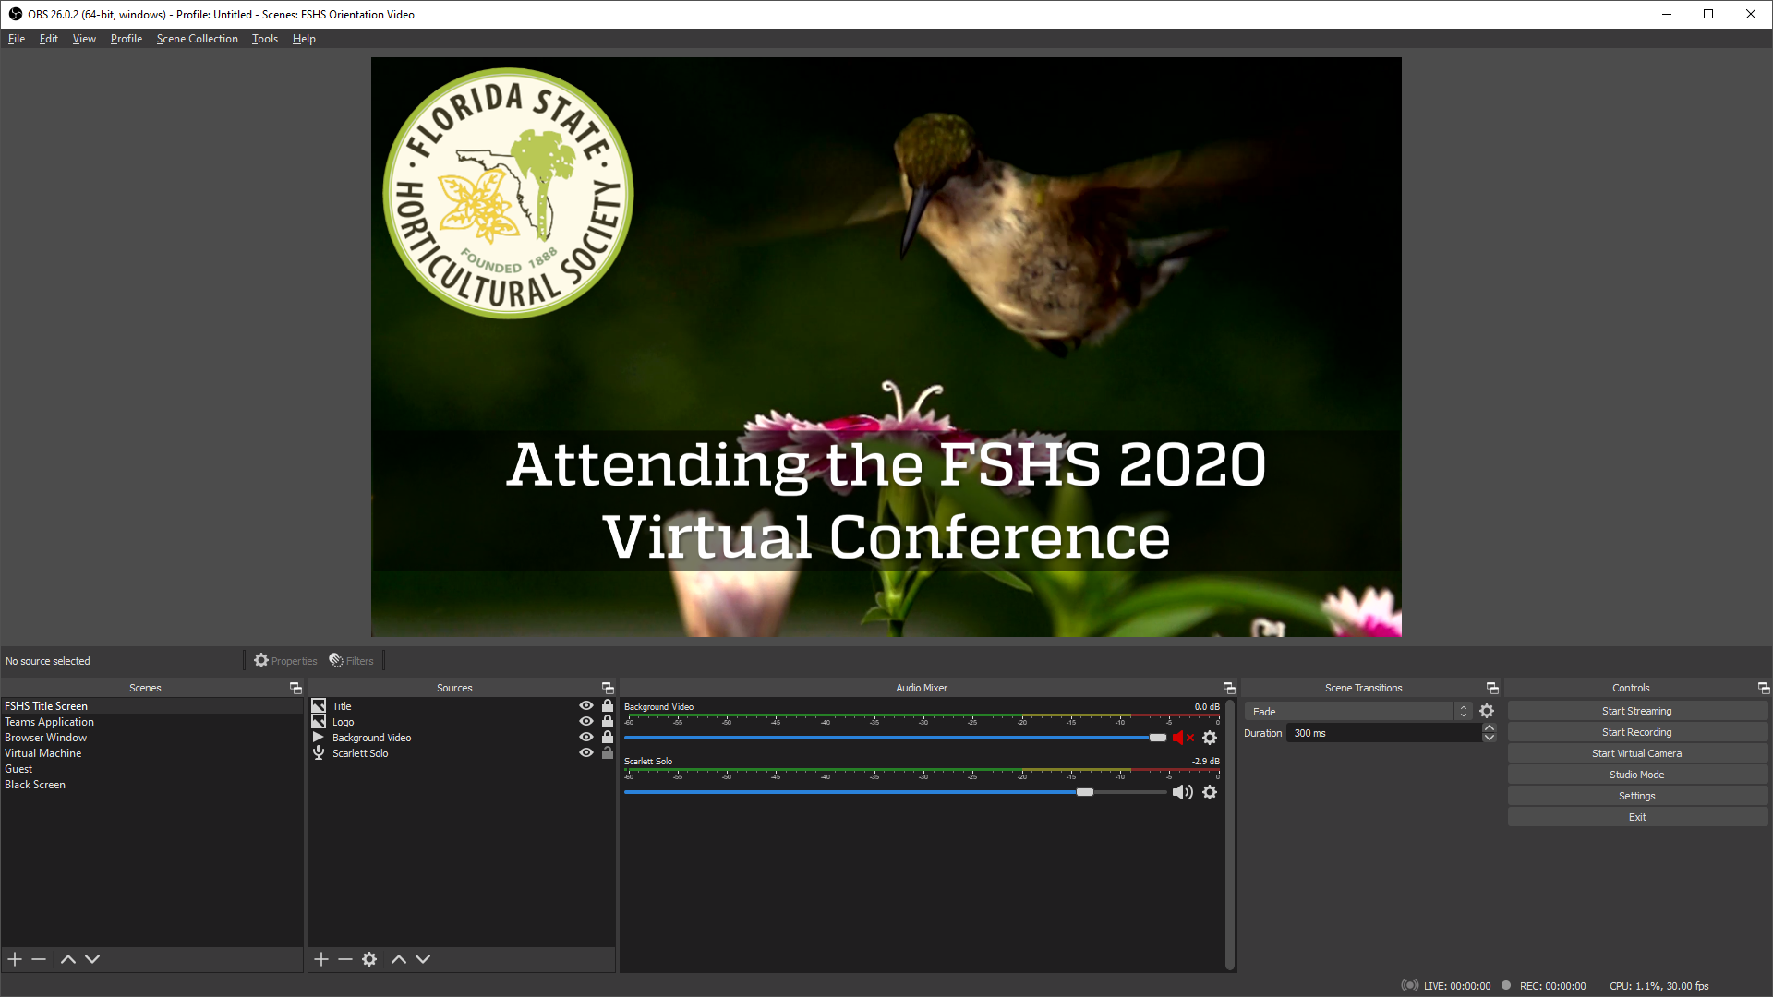
Building a Virtual Venue
Understand stakeholder goals
Build a demo team
Train facilitators, moderators
Set attendee expectations
Notes:
DWAYNE

Slide 44
How Teams?
Building a Virtual Venue
Understand stakeholder goals
Build a demo team
Train facilitators, moderators
Set attendee expectations
Build a production team

Slide 45
elseif ($Channel.BreakoutQty -gt 0) {
if ($Channel.BreakoutQty -le 99) {
1..$Channel.BreakoutQty |
ForEach-Object {
$ChannelBrkOName = "$ChannelName" + ("{0:D2}" -f $_)
New-TeamChannel -GroupId $GroupId -DisplayName $ChannelBrkOName
}
if ($null -ne $Channel.emoji) {
$NewChannelRoot = "$($Channel.emoji) $($ChannelName)"
Start-Sleep -Seconds 5
1..$Channel.BreakoutQty |
ForEach-Object {
$ChannelBrkOName = "$ChannelName" + ("{0:D2}" -f $_)
$ChannelNewName = "$NewChannelRoot" + ("{0:D2}" -f $_)
Set-TeamChannel -GroupId $GroupId -CurrentDisplayName `
$ChannelBrkOName -NewDisplayName $ChannelNewName
}
}
Notes:
JOE
Once we have finalized channel names, emojis, and poster/breakout rooms, we’ll use PowerShell to build out the production team’s channels.
We prefer to name the channels without the emoji and then rename adding the emoji – keeps any SharePoint URLs free of the emoji character. It’s just a preference and it might confusing to attendees if we expose a SharePoint URL to them.
With a lot of manual work while building the demo team, we use code to ensure the cleanest and fewest changes in the production team.

Slide 46
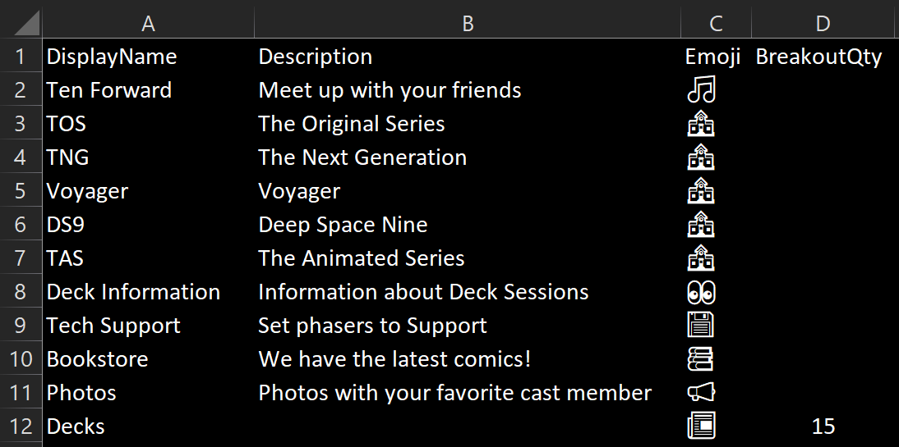
Notes:
JOE
We use an an Excel Template file for creating the team channels – generating multiple poster channels as needed. Excel handles emojis ☺ nicely.
So that gets the team setup, next we work on adding the attendees - members and guests.

Slide 47
#Generate initial invites
foreach ($email in $Invitations) {
$Params = @{
InvitedUserEmailAddress = $email.EmailAddress;
InvitedUserDisplayName = $email.DisplayName;
InviteRedirectUrl = $InviteRedirectUrl;
InvitedUserMessageInfo = $MessageInfo;
SendInvitationMessage = $true;
InvitedUserType = 'Guest';
}
try {
Write-Output "Inviting: $($email.EmailAddress)"
$NewInvite = New-AzureADMSInvitation @Params
"$($email.DisplayName),$($email.EmailAddress), `
$($NewInvite.InvitedUser.Id),$($NewInvite.Status)" |
Out-File $InvitedFile -Force -Append
}
catch {
Write-Output "Error inviting: $($email.EmailAddress)"
"$($email.DisplayName),$($email.EmailAddress),,FAILED" |
Out-File $InvitedFile -Force -Append
}
}
Notes:
JOE
We automate the adding of our own tenant’s members to the team, also with PowerShell, using the standard Microsoft Teams module.
Another major automation though is managing bulk invites to external guests.
One of our conferences had 1300 guests.
We use the Azure AD module to send out the bulk invites.
Tip – in your registration process, try to collect UnityID, eID, NetID, etc. –the authentication account of the attendees for smoother invite activations.

Slide 48
#Resend invites
foreach ($email in $Invitations) {
$Params = @{
InvitedUserEmailAddress = $email.EmailAddress;
InviteRedirectUrl = $InviteRedirectUrl;
SendInvitationMessage = $true;
}
try {
Write-Output "Inviting: $($email.EmailAddress)"
$NewInvite = New-AzureADMSInvitation @Params
"$($email.DisplayName),$($email.EmailAddress), `
$($NewInvite.InvitedUser.Id),$($NewInvite.Status)" |
Out-File $InvitedFile -Force -Append
}
catch {
Write-Output "Error inviting: $($email.EmailAddress)"
"$($email.DisplayName),$($email.EmailAddress),,FAILED" |
Out-File $InvitedFile -Force -Append
}
}
Notes:
JOE
With some additional code you can get the status of invites looking for those with PendingAcceptance status.
Then with a slight change of code, we would resend the invites to those with that pending status. So as we get closer to the conference start, we would begin sending reinvites. We like to have 4 or 5 days to work when having a large number of external guests.
Tip – when running the invite code, use an account of a known conference organizer – someone likely known to the attendees, as the email invites will come with the code runner’s name and their profile picture.
And that’s important, because of how these invites look when arriving in your attendee's inboxes…

Slide 49
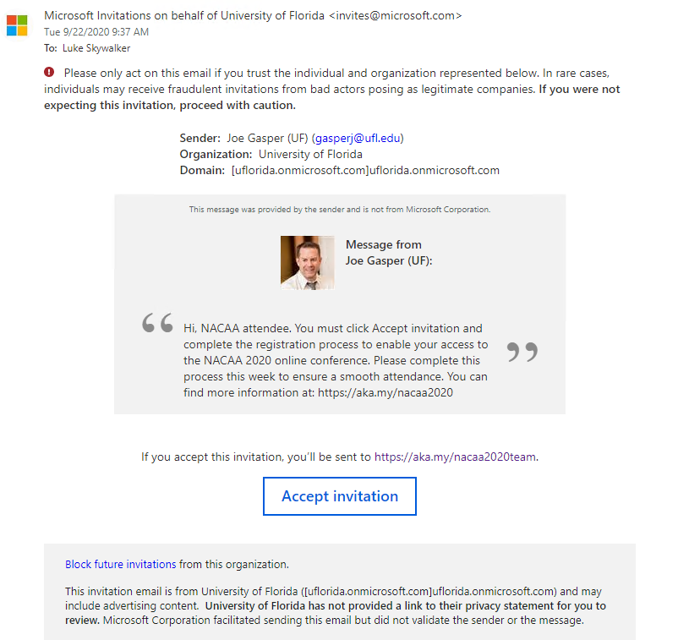
Notes:
JOE
This is not an inviting invitation!
Prior to sending out these invites, we recommend sending the attendees basically a heads-up – “expect to see an invite email soon” – give them an example screenshot even of what’s coming.
Because they are going to receive an email that states things like: “act on this email only if you trust the individual” – “bad actors” – “proceed with caution” – “block future invitations”
A lot can go wrong here.
This is the number 1 support issue we had with guests – “I can’t find my invitation”.
Have users check spam and blocked email reports - they were often sitting there.

Slide 50
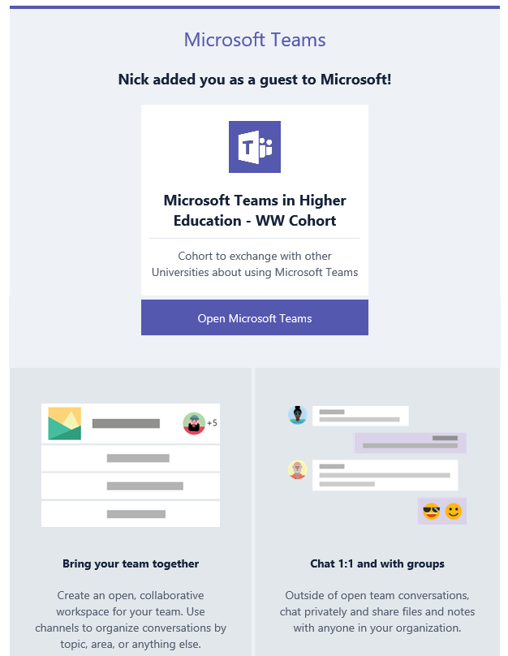
VS.
Notes:
JOE
If you have perhaps a few dozen guests, you might consider adding them manually because they have a better onboarding email as you can see on the right.
That’s a much more inviting and professional looking email.

Slide 51
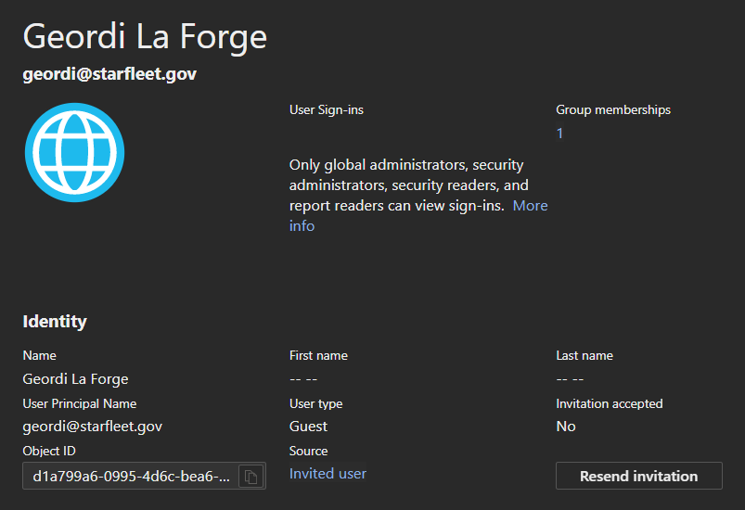
Notes:
JOE
And if you still have problems cutting through spam filters, you can also, if enabled, access Azure AD portal and manually resend an invitation.
The resent invitation will state that it was sent from whomever clicks the Resend button.
But you will also get an invitation link you can directly email or message to the guest and you can get past spam blockers and that will get them added in to team.
And that’s the last of our major sections on the build out – now on to a FEW collected tips we’ve compiled running these events.

Slide 52
A Few Tips 😀
Service accounts for meetings | Toggle visible channels | “Staff Only” private channel
Schedule before adding | Moderate channels | General channel is different
SPO list/page for team links | Use SPO page tabs not web | Use embed code for YT tab
No PPT team browse in NME | No Quick Poll in NME chat | NME randomly enabled
No .ppt/.pptm, only .pptx | Please, no 4:3 PPT ☹ | Optimize PowerPoint decks
Rename .pptx to .zip | Autoplay embedded videos | Compress to web (150 ppi)
No team icon for guests | No profile pic for guests | No Quick Polls for guests
No PPT share for guests | Guest’s virtual backgrounds | Guests can’t start meetings
No grid view for guests | Set guest display name! | Test as guest
Short URL for LE externally | Use image for SPO spaces | Ask for UnityId, eID, NetID
Notes:
DEWAYNE
Service accounts for meetings – enables multiple assistances to manage scheduled channel meetings, instead of relying on a single human to manage the first promotion of someone to a presenter role. The service account as the meeting organizer will have management access to any meeting recordings.
JOE
SPO list/page for team links – When you compile or use hyperlinks to Teams objects, like to channels, posts, meetings, or files – place them on SharePoint pages or lists that have you tab in using the SharePoint app. Often hyperlinks to Teams objects on a website tab, or PDF, can launch the user out to a web browser, only to be redirected back into the team. So make good use of SharePoint in the conference team.
DEWAYNE
The notes for this slide will cover the rest of the tips
BONUS #1 – When using PowerPoint sharing – hyperlinks on slides are active for the viewers – so think about links to additional information, YouTube video, your blog, etc.
BONUS #2 – Create subfolders in the channels with access to view only for members – place slide decks, supplemental material, and recordings (if you have team guests as they can’t access Stream content).
Toggle visible channels – we’ve seen where channels you want visible don’t show automatically. Give them a toggle to not show/show after adding the members.
“Staff Only” private channel – use for placing content getting ready for adding to public channels, chat among moderators and organizers, collect attendance reports.
Schedule before adding – consider creating scheduled channel meetings prior to adding members – worry about possibly dozens of calendar invites going out to hundreds of attendees (and not expected to attended every meeting…)
Moderate channels – Enable moderation and have a team owner (or channel moderator) post welcome/information posts or create channel meetings – this will keep the posts an meetings more visible in the channel posts and gives the attendees an initial post to which they can reply if needed. It keeps the channels clean of random questions or ad-hoc instance meetings.
General channel is different – we are seeing the General channel moderation behaving differently than its possible settings (it seems to allow replies even when disabled – so test your expectations).
SPO list/page for team links – Links to Teams objects – channel, post, team, meeting, etc. – if hyperlinked in an SPO page/list, on click will keep the attendee ‘Inside” the team interface, instead of first launching them to a web browser (only to be redirected back to the team).
Use SPO page tabs not web – website tabs to SPO can cause an authentication request, we’ve seen that using an SPO page/list Tab app prevents additional authentication requests.
Use embed code for YT tab – Get the embed code for YouTube videos when adding a YouTube tab – and to the URL works, too: ?autoplay=1
No PPT team browse in NME – New meeting experience is broken – you can’t browse Teams for a slide deck when sharing PowerPoint.
No Quick Poll in NME chat – New meeting experience is broken – you can’t generate a Quick Poll in the pop-out meeting chat (for a channel meeting, you can go to the same meeting chat in the main Teams interface and create the Quick Pool as usual.
NME randomly enabled – we have seen the user choice for new meeting experience to be randomly enabled.
No .ppt/.pptm, only .pptx – You can only share .pptx file type for PowerPoint sharing.
Please, no 4:3 PPT ☹ - 16:9 for online presentations – 4:3 is not a good experience for the viewer.
Optimize PowerPoint decks – use the built-in tools for Picture compression and Video compression to keep your slide decks file sizes as small as possible – good bandwidth etiquette for attendees.
Rename .pptx to .zip – If you can’t figure out what is causing a large file size, make a copy of your .pptx file and rename to a .zip file. Then unzip the file and look in /ppt/media for all pictures and video files.
Autoplay embedded videos – Embed the videos and set them to autoplay – that is the only way to play the video for all viewers when using PowerPoint sharing. If you link to a YouTube video, each attendee will have to click the slide to start their personal viewing of the video.
Compress to web (150 ppi) – When optimizing your images using Picture compression, use the setting web (150 ppi) or lower resolution to keep the file smaller (the viewers are watching over the web, not printing).
No team icon for guests – Teams guest experience needs improving – Guests don’t see the Teams’ icon.
No profile pic for guests - Teams guest experience needs improving – Guests can’t set a profile icon - would be helpful for engagement and connecting peers.
No Quick Polls for guests - Teams guest experience needs improving – Guests can’t participate in a Quick Poll (seems quick polls are set to organization only responses).
No PPT share for guests - Teams guest experience needs improving – Guests can only share their screen or an application.
Guests virtual backgrounds - Teams guest experience needs improving – Guests must set their background prior to switching tenants.
Guests can’t start meetings - Teams guest experience needs improving – like it says.
No grid view for guests - Teams guest experience needs improving – good or bad, something to consider when giving overviews to attendees.
Set guest display name! - Teams guest experience needs improving – You need to set the guest’s display name at time of adding to the team or you will need an Azure AD admin to update.
Test as guest - Teams guest experience needs improving - with the number of quirks, just make sure you understand the guest experience – none of them are blockers to a successful event.
Short URL for LE externally – When sharing an attendee link to a live event via a hyperlink posted inside a team, use the full link URL for best attendee experience (it will keep them in the Teams interface). If sharing a live event link outside the team, use a short URL service for the link if sending in a medium that you can’t update (i.e., a sent email). Use a shortener service that allows the target to be updated (i.e., aka.my) so that if the live event is accidently ended early, you at least have an opportunity to update the short URL to the new live event link.
Use image for SPO spaces – If adding a large format PDF (i.e., posters – 50in x 50in), consider exporting the PDF to an image file (png/jpg) as the auto-generated thumbnail for large format PDFs will currently cut off portions of the PDF.
Ask for UnityId, eID, NetID - Teams guest experience needs improving – Try to get the true authentication account of guests to reduce difficulties joining the team – ask for what you use when logging on to their computers or Office 365.

Slide 53









4 Conferences
293 years of tradition
$3.5
million
2541
396
attendees (↑84%)
presentations
147
247
meetings
meeting hours
2269
5658
messages
reactions
Notes:
Metrics covering our 4 online conferences
DEWAYNE
History of meetings – 133 year, 105 years, 34, 21…
JOE
As we’ve been talking about why teams, we can see there’s been 150 individual meetings, 400 presentations – imagine scaling out and managing that many individual stand-alone siloed meetings. How would bring all that back in some coherent manner? We’ve got 4 teams, so we’ve basically done that in 4 links.
What’s the future for higher education conferences and symposiums?
100% Online?
Hybrid?
Need training and skill up of Event Coordination departments.
Feedback we’ve received says continue with online components:
easy access to content, recordings, slide decks
asynchronous participation
continued connection with colleagues
247 meeting hours = 31 workdays
16 hours in 6 live events.
The Future?

Slide 54

GITHUB.COM/SHIFTSHOW/HIEDCON
aka.my/hiedrepo
Notes:
JOE or DEWAYNE
This slide deck, scripts, other tools and services we use are in this repo for you.
https://github.com/shiftshow/HiEdCon

Slide 55
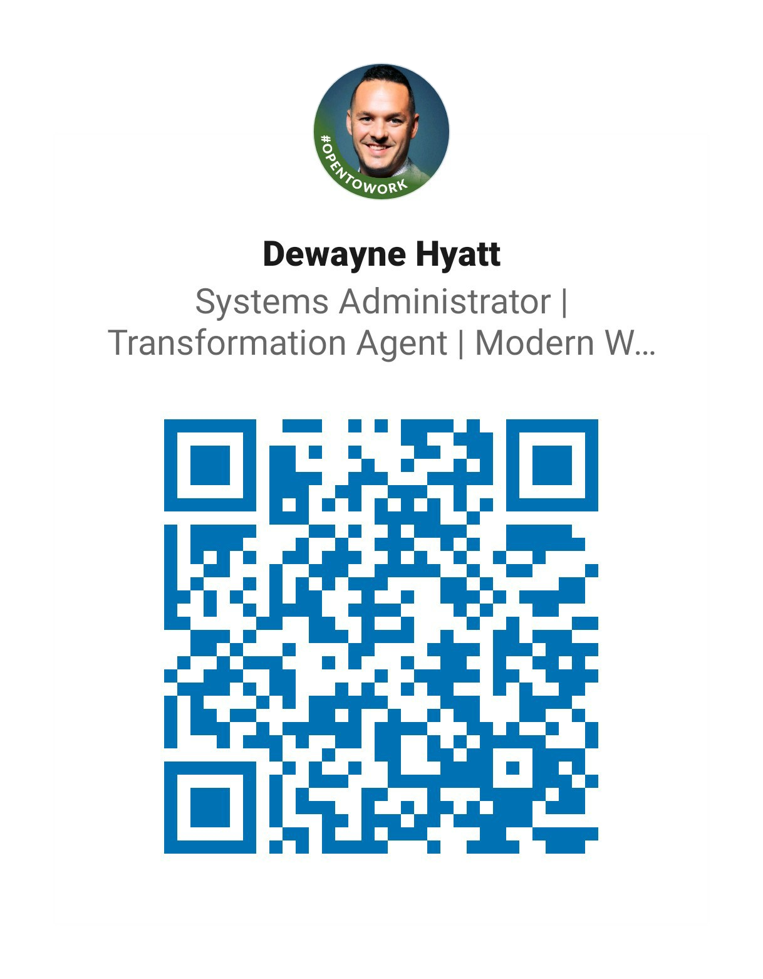
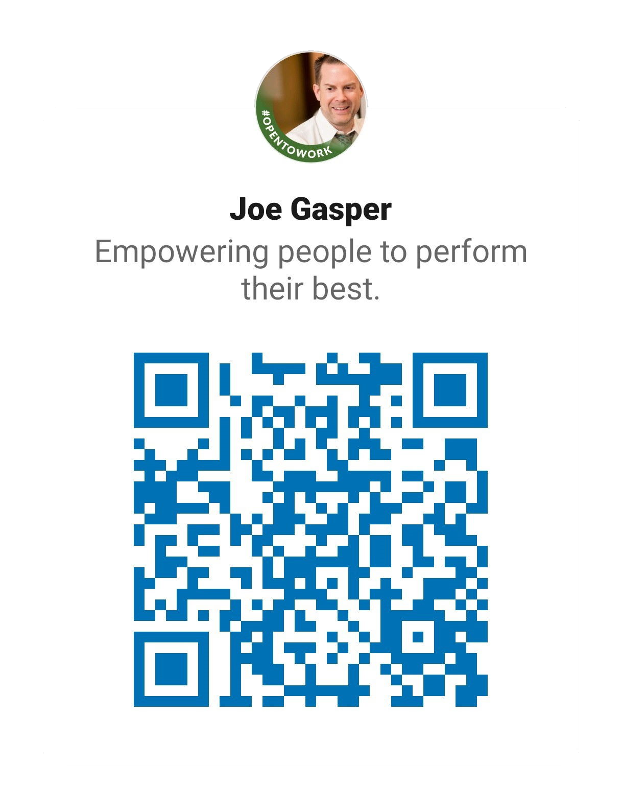

GITHUB.COM/SHIFTSHOW/HIEDCON
/in/dewaynehyatt
dehyatt@ufl.edu
/in/joegasper
gasperj@ufl.edu
Notes:
Thank you. Please connect.

Slide 56

PODCAST
COMING SOON

